Slide 1
Analysis Results from Folder - B4_B06_15.58_16.56

Slide 2
Analysis Results:
Metric | Value
Total time taken for the ride | 0 days 00:58:37.185000
Actual Ampere-hours (Ah) | 33.038110833333334
Actual Watt-hours (Wh) | 1691.0718167533332
Starting SoC (Ah) | 39.476
Ending SoC (Ah) | 7.414
Starting SoC (%) | 18.0
Ending SoC (%) | 99.0
Total distance covered (in kilometers) | 40.782274200087784
WH/KM | 41.46585372989556
Total SOC consumed | 81.0
Mode | Custom mode 74.37% Eco mode 20.71% Sports mode 1.64%
Peak Power | 4502.33508
Average Power | -1738.8913282810624

Slide 3
Analysis Results:
Metric | Value
Total Energy Regenerated | 0.0764918
Regenerative Effectiveness | -0.004523068710953785
Lowest Cell Voltage | 3.094
Highest Cell Voltage | 3.394
Difference in Cell Voltage | 0.30000000000000027
Minimum Temperature | 36.0
Maximum Temperature | 45.0
Difference in Temperature | nan
Maximum Fet Temperature | 61.0
Maximum Afe Temperature | 60.0
Maximum PCB Temperature | 60.0
Maximum MCU Temperature | 50.0
Maximum Motor Temperature | 95.0

Slide 4
Analysis Results:
Metric | Value
Abnormal Motor Temperature Detected | False
lowest cell temp | 45.0
highest cell temp | 36.0
Difference between Highest and Lowest Cell Temperature at 100% SOC | 9.0
Maximum BMS Temperature in C | 61.0
Battery Voltage | 5.3
Total energy charged in kWh | 0.17510198741666666
Electricity consumption units in kW | 1.3829809766583471e-08
Idling time percentage | 8.785529715762273
Time spent in 0-10 km/h | 13.106690327200274
Time spent in 10-20 km/h | 2.3753930450484106
Time spent in 20-30 km/h | 5.220883534136546
Time spent in 30-40 km/h | 10.8962983717817

Slide 5
Analysis Results:
Metric | Value
Time spent in 40-50 km/h | 11.023940724136857
Time spent in 50-60 km/h | 51.57062357958968
Time spent in 60-70 km/h | 4.37719871735002

Slide 6
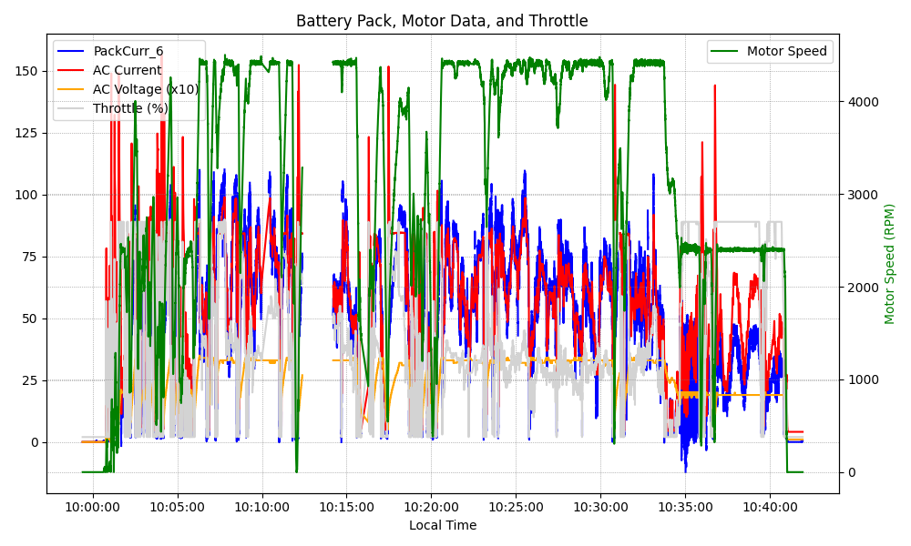
Graph Analysis

