Slide 1
Analysis Results from Folder - B3_B07_16.40_17.38

Slide 2
Analysis Results:
Metric | Value
Total time taken for the ride | 0 days 00:59:17.031000
Actual Ampere-hours (Ah) | 25.200022777777775
Actual Watt-hours (Wh) | 1288.723236378611
Starting SoC (Ah) | 38.279
Ending SoC (Ah) | 12.818
Starting SoC (%) | 32.0
Ending SoC (%) | 96.0
Total distance covered (in kilometers) | 31.11078368427709
WH/KM | 41.423682844412305
Total SOC consumed | 64.0
Mode | Custom mode 59.03% Eco mode 34.13% Sports mode 0.03%
Peak Power | 6127.99704
Average Power | -1311.3068544270775

Slide 3
Analysis Results:
Metric | Value
Total Energy Regenerated | 55.21605070694445
Regenerative Effectiveness | -4.108522701697714
Lowest Cell Voltage | 3.09
Highest Cell Voltage | 3.334
Difference in Cell Voltage | 0.24400000000000022
Minimum Temperature | 32.0
Maximum Temperature | 42.0
Difference in Temperature | nan
Maximum Fet Temperature | 69.0
Maximum Afe Temperature | 65.0
Maximum PCB Temperature | 64.0
Maximum MCU Temperature | 53.0
Maximum Motor Temperature | 0.0

Slide 4
Analysis Results:
Metric | Value
Abnormal Motor Temperature Detected | False
lowest cell temp | 42.0
highest cell temp | -52.0
Difference between Highest and Lowest Cell Temperature at 100% SOC | 94.0
Maximum BMS Temperature in C | 69.0
Battery Voltage | 5.5
Total energy charged in kWh | 0.13860012527777774
Electricity consumption units in kW | 1.0823737643908547e-08
Idling time percentage | 3.4818134699228636
Time spent in 0-10 km/h | 27.39717674319339
Time spent in 10-20 km/h | 4.381231135095582
Time spent in 20-30 km/h | 8.863075093752858
Time spent in 30-40 km/h | 18.695691941827494

Slide 5
Analysis Results:
Metric | Value
Time spent in 40-50 km/h | 15.143754382755573
Time spent in 50-60 km/h | 19.104240982956796
Time spent in 60-70 km/h | 5.902618982286045

Slide 6
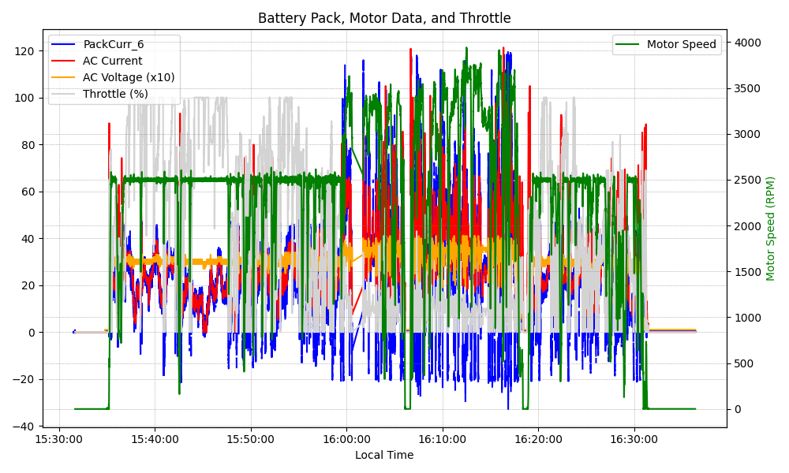
Graph Analysis

