Slide 1
Analysis Results from Folder - B3_B03_15.25_17.37

Slide 2
Analysis Results:
Metric | Value
Total time taken for the ride | 0 days 02:11:22.382000
Actual Ampere-hours (Ah) | 33.47750777777778
Actual Watt-hours (Wh) | 1736.0360734966666
Starting SoC (Ah) | 37.326
Ending SoC (Ah) | 5.944
Starting SoC (%) | 15.0
Ending SoC (%) | 100.0
Total distance covered (in kilometers) | 70.59788385330441
WH/KM | 24.59048315249763
Total SOC consumed | 85.0
Mode | Eco mode 77.10% Sports mode 18.20% Custom mode 0.05%
Peak Power | 5317.71037
Average Power | -799.4026432064467

Slide 3
Analysis Results:
Metric | Value
Total Energy Regenerated | 69.98707205138889
Regenerative Effectiveness | -3.875203494701095
Lowest Cell Voltage | 3.05
Highest Cell Voltage | 3.522
Difference in Cell Voltage | 0.472
Minimum Temperature | 38.0
Maximum Temperature | 48.0
Difference in Temperature | 1.0
Maximum Fet Temperature | 63.0
Maximum Afe Temperature | 67.0
Maximum PCB Temperature | 61.0
Maximum MCU Temperature | 46.0
Maximum Motor Temperature | 0.0

Slide 4
Analysis Results:
Metric | Value
Abnormal Motor Temperature Detected | False
lowest cell temp | 48.0
highest cell temp | 38.0
Difference between Highest and Lowest Cell Temperature at 100% SOC | 10.0
Maximum BMS Temperature in C | 63.0
Battery Voltage | 5.6
Total energy charged in kWh | 0.18747404355555558
Electricity consumption units in kW | 6.606968181917857e-09
Idling time percentage | 4.693763919821826
Time spent in 0-10 km/h | 12.437360801781736
Time spent in 10-20 km/h | 6.542316258351893
Time spent in 20-30 km/h | 8.094376391982184
Time spent in 30-40 km/h | 48.48273942093541

Slide 5
Analysis Results:
Metric | Value
Time spent in 40-50 km/h | 24.19543429844098
Time spent in 50-60 km/h | 0.0
Time spent in 60-70 km/h | 0.0

Slide 6
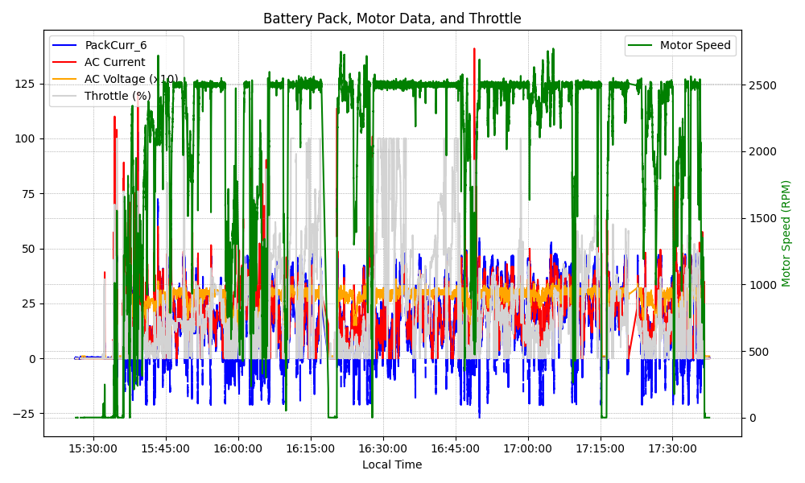
Graph Analysis

