Slide 1
Analysis Results from Folder - B3_B04_09.05_10.20

Slide 2
Analysis Results:
Metric | Value
Total time taken for the ride | 0 days 01:14:17.096000
Actual Ampere-hours (Ah) | 34.34780416666667
Actual Watt-hours (Wh) | 1732.0194386866667
Starting SoC (Ah) | 38.28
Ending SoC (Ah) | 3.652
Starting SoC (%) | 9.0
Ending SoC (%) | 96.0
Total distance covered (in kilometers) | 38.289858767393895
WH/KM | 45.23441700865151
Total SOC consumed | 87.0
Mode | Custom mode 66.05% Eco mode 30.54% Sports mode 0.09%
Peak Power | 6125.566505
Average Power | -1406.240410300406

Slide 3
Analysis Results:
Metric | Value
Total Energy Regenerated | 112.39954932722223
Regenerative Effectiveness | -6.094035577472369
Lowest Cell Voltage | 2.921
Highest Cell Voltage | 3.337
Difference in Cell Voltage | 0.41600000000000037
Minimum Temperature | 21.0
Maximum Temperature | 45.0
Difference in Temperature | nan
Maximum Fet Temperature | 72.0
Maximum Afe Temperature | 66.0
Maximum PCB Temperature | 64.0
Maximum MCU Temperature | 51.0
Maximum Motor Temperature | 0.0

Slide 4
Analysis Results:
Metric | Value
Abnormal Motor Temperature Detected | False
lowest cell temp | 45.0
highest cell temp | 21.0
Difference between Highest and Lowest Cell Temperature at 100% SOC | 24.0
Maximum BMS Temperature in C | 72.0
Battery Voltage | 5.5
Total energy charged in kWh | 0.18891292291666667
Electricity consumption units in kW | 1.1773796706595534e-08
Idling time percentage | 12.735038766887971
Time spent in 0-10 km/h | 25.999350016249593
Time spent in 10-20 km/h | 5.155763963043781
Time spent in 20-30 km/h | 8.284971447142393
Time spent in 30-40 km/h | 21.635173406379128

Slide 5
Analysis Results:
Metric | Value
Time spent in 40-50 km/h | 15.34425925066159
Time spent in 50-60 km/h | 9.824040113282882
Time spent in 60-70 km/h | 10.545986350341241

Slide 6
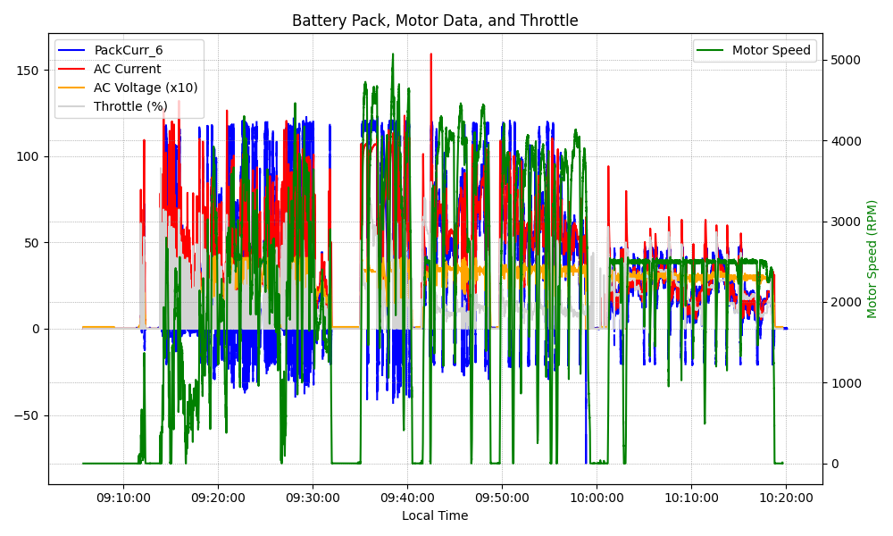
Graph Analysis

