Slide 1
Analysis Results from Folder - B3_B04_17.38_19.29

Slide 2
Analysis Results:
Metric | Value
Total time taken for the ride | 0 days 01:51:05.326000
Actual Ampere-hours (Ah) | 31.127703055555557
Actual Watt-hours (Wh) | 1615.3908562836111
Starting SoC (Ah) | 5.944
Ending SoC (Ah) | 6.418
Starting SoC (%) | 15.0
Ending SoC (%) | 100.0
Total distance covered (in kilometers) | 57.7466072884102
WH/KM | 27.973779450205406
Total SOC consumed | 1.0
Mode | Eco mode 85.95% Sports mode 13.67%
Peak Power | 4429.9909450000005
Average Power | -877.0030285961393

Slide 3
Analysis Results:
Metric | Value
Total Energy Regenerated | 68.13299414972222
Regenerative Effectiveness | -4.047046564394381
Lowest Cell Voltage | 3.144
Highest Cell Voltage | 3.483
Difference in Cell Voltage | 0.33899999999999997
Minimum Temperature | 36.0
Maximum Temperature | 48.0
Difference in Temperature | 0.0
Maximum Fet Temperature | 58.0
Maximum Afe Temperature | 63.0
Maximum PCB Temperature | 59.0
Maximum MCU Temperature | 43.0
Maximum Motor Temperature | 0.0

Slide 4
Analysis Results:
Metric | Value
Abnormal Motor Temperature Detected | False
lowest cell temp | 48.0
highest cell temp | 36.0
Difference between Highest and Lowest Cell Temperature at 100% SOC | 12.0
Maximum BMS Temperature in C | 58.0
Battery Voltage | 5.6
Total energy charged in kWh | 0.1743151371111111
Electricity consumption units in kW | 7.264946949700388e-09
Idling time percentage | 6.860297239915074
Time spent in 0-10 km/h | 12.331210191082803
Time spent in 10-20 km/h | 8.811889596602972
Time spent in 20-30 km/h | 14.236942675159236
Time spent in 30-40 km/h | 42.01104033970276

Slide 5
Analysis Results:
Metric | Value
Time spent in 40-50 km/h | 22.364331210191082
Time spent in 50-60 km/h | 0.0
Time spent in 60-70 km/h | 0.0

Slide 6
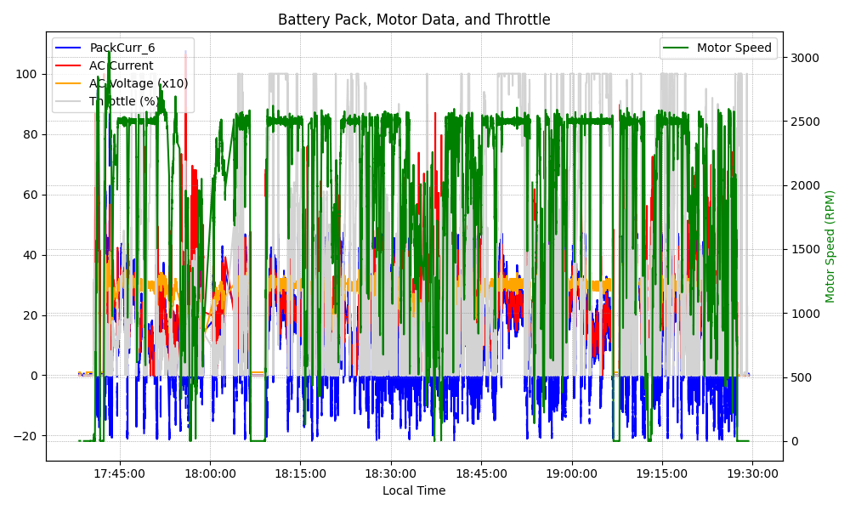
Graph Analysis

