Slide 1
Analysis Results from Folder - B3_B05_20.41_21.37

Slide 2
Analysis Results:
Metric | Value
Total time taken for the ride | 0 days 00:55:20.893000
Actual Ampere-hours (Ah) | 31.595891666666663
Actual Watt-hours (Wh) | 1613.4894348891664
Starting SoC (Ah) | 39.532
Ending SoC (Ah) | 12.329
Starting SoC (%) | 31.0
Ending SoC (%) | 99.0
Total distance covered (in kilometers) | 32.71985919962416
WH/KM | 49.31223649360019
Total SOC consumed | 68.0
Mode | Custom mode 85.53% Eco mode 4.29% Sports mode 0.22%
Peak Power | 6138.107433
Average Power | -1756.9757911678762

Slide 3
Analysis Results:
Metric | Value
Total Energy Regenerated | 72.2175989013889
Regenerative Effectiveness | -4.284113280289114
Lowest Cell Voltage | 3.062
Highest Cell Voltage | 3.454
Difference in Cell Voltage | 0.39200000000000035
Minimum Temperature | 34.0
Maximum Temperature | 44.0
Difference in Temperature | nan
Maximum Fet Temperature | 70.0
Maximum Afe Temperature | 63.0
Maximum PCB Temperature | 61.0
Maximum MCU Temperature | 48.0
Maximum Motor Temperature | 0.0

Slide 4
Analysis Results:
Metric | Value
Abnormal Motor Temperature Detected | True
lowest cell temp | 44.0
highest cell temp | -1.0
Difference between Highest and Lowest Cell Temperature at 100% SOC | 45.0
Maximum BMS Temperature in C | 70.0
Battery Voltage | 5.5
Total energy charged in kWh | 0.17377740416666665
Electricity consumption units in kW | 1.4539608782351628e-08
Idling time percentage | 12.933383800151402
Time spent in 0-10 km/h | 22.301286903860714
Time spent in 10-20 km/h | 3.917486752460257
Time spent in 20-30 km/h | 8.0999242997729
Time spent in 30-40 km/h | 11.669190007570023

Slide 5
Analysis Results:
Metric | Value
Time spent in 40-50 km/h | 16.30204390613172
Time spent in 50-60 km/h | 16.003028009084026
Time spent in 60-70 km/h | 16.086298258894775

Slide 6
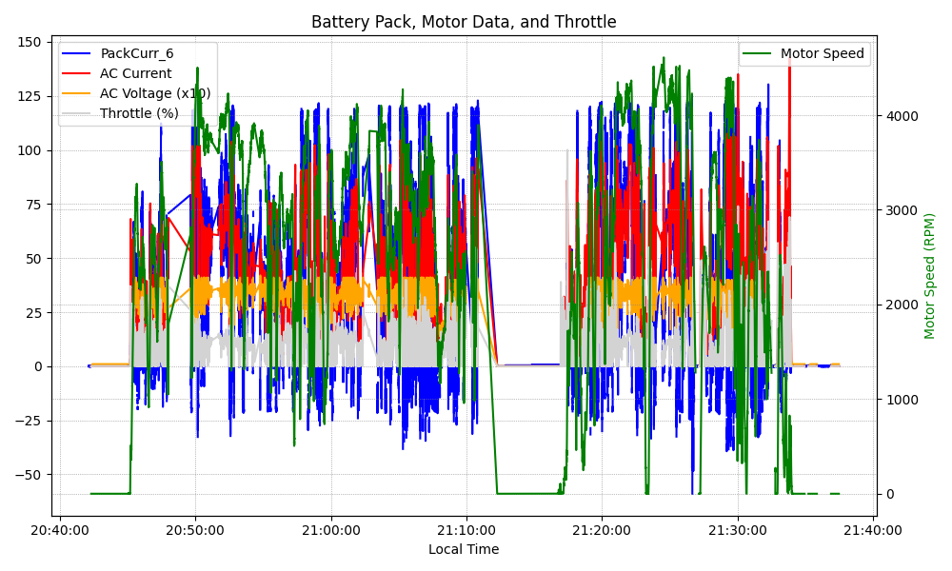
Graph Analysis

