Slide 1
Analysis Results from Folder - B4_17.33_21.40

Slide 2
Analysis Results:
Metric | Value
Total time taken for the ride | 0 days 04:06:54.515000
Actual Ampere-hours (Ah) | 91.007305
Actual Watt-hours (Wh) | 4678.466202109445
Starting SoC (Ah) | 6.595
Ending SoC (Ah) | 12.329
Starting SoC (%) | 100.0
Ending SoC (%) | 6.0
Total distance covered (km) | 133.9870433540938
Total energy consumption(WH/KM) | 34.91730308389181
Total SOC consumed(%) | 15.0
Mode | Eco mode 46.12% Custom mode 41.28% Sports mode 9.00%
Peak Power(kW) | 6239.258608
Average Power(kW) | -1143.5685991033406

Slide 3
Analysis Results:
Metric | Value
Total Energy Regenerated(kWh) | 248.90614259916669
Regenerative Effectiveness(kWh) | -5.051498551077859
Highest Cell Voltage(V) | 3.483
Lowest Cell Voltage(V) | 3.05
Difference in Cell Voltage(V) | 0.4330000000000003
Minimum Temperature(C) | 34.0
Maximum Temperature(C) | 48.0
Difference in Temperature(C) | 14.0
Maximum Fet Temperature-BMS(C) | 71.0
Maximum Afe Temperature-BMS(C) | 67.0
Maximum PCB Temperature-BMS(C) | 67.0
Maximum MCU Temperature(C) | 48.0
Maximum Motor Temperature(C) | 0.0

Slide 4
Analysis Results:
Metric | Value
Abnormal Motor Temperature Detected(C) | True
highest cell temp(C) | 48.0
lowest cell temp(C) | -1.0
Difference between Highest and Lowest Cell Temperature at 100% SOC(C) | 49.0
Battery Voltage(V) | 56.0
Total energy charged(kWh) | 5.09640908
Electricity consumption units(kW) | 9.556292621094161e-08
Idling time percentage | 11.017601270077842
Time spent in 0-10 km/h | 7.2195177268198645
Time spent in 10-20 km/h | 7.752496820755404
Time spent in 20-30 km/h | 12.19371927067724
Time spent in 30-40 km/h | 27.67117295900597
Time spent in 40-50 km/h | 18.34322881651101

Slide 5
Analysis Results:
Metric | Value
Time spent in 50-60 km/h | 9.49804385332545
Time spent in 60-70 km/h | 5.365430878767506
Time spent in 70-80 km/h | 0.21626963234162502
Time spent in 80-90 km/h | 0.0

Slide 6
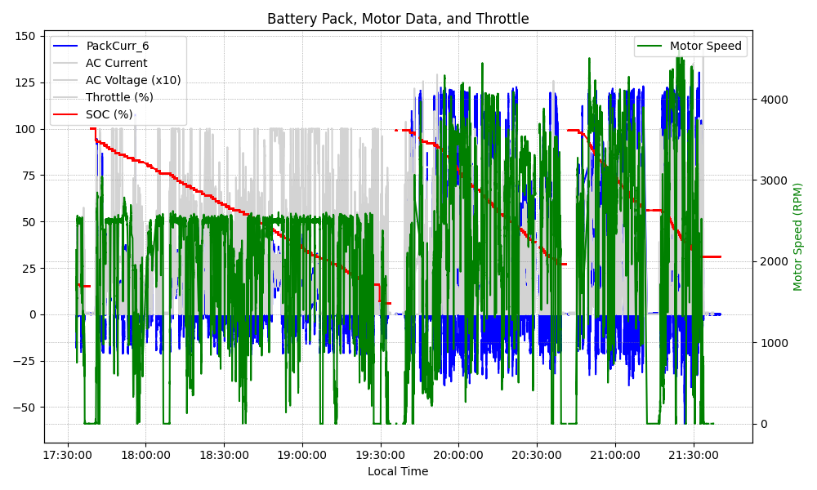
Graph Analysis

