Slide 1
Analysis Results from Folder - B4_BT03_14.54_15.49

Slide 2
Analysis Results:
Metric | Value
Total time taken for the ride | 0 days 00:54:33.080000
Actual Ampere-hours (Ah) | 33.50824527777778
Actual Watt-hours (Wh) | 1709.2071987016664
Starting SoC (Ah) | 37.269
Ending SoC (Ah) | 3.638
Starting SoC (%) | 94.0
Ending SoC (%) | 9.0
Total distance covered (km) | 37.58748425011527
Total energy consumption(WH/KM) | 45.47277458976055
Total SOC consumed(%) | 85.0
Mode | Custom mode 67.83% Eco mode 32.17%
Peak Power(kW) | 4552.1056
Average Power(kW) | -1888.0472277772321

Slide 3
Analysis Results:
Metric | Value
Total Energy Regenerated(kWh) | 2.3885110119444444
Regenerative Effectiveness(%) | 0.13954878470360835
Highest Cell Voltage(V) | 3.35
Lowest Cell Voltage(V) | 3.047
Difference in Cell Voltage(V) | 0.30299999999999994
Minimum Temperature(C) | 37.0
Maximum Temperature(C) | 47.0
Difference in Temperature(C) | 10.0
Maximum Fet Temperature-BMS(C) | 70.0
Maximum Afe Temperature-BMS(C) | 67.0
Maximum PCB Temperature-BMS(C) | 65.0
Maximum MCU Temperature(C) | 68.0
Maximum Motor Temperature(C) | 100.0

Slide 4
Analysis Results:
Metric | Value
Abnormal Motor Temperature Detected(C) | False
highest cell temp(C) | 47.0
lowest cell temp(C) | 37.0
Difference between Highest and Lowest Cell Temperature at 100% SOC(C) | 10.0
Battery Voltage(V) | 53.0
Total energy charged(kWh) | 1.7759369997222225
Electricity consumption units(kW) | 1.5072283325883683e-07
Idling time percentage | 1.3077069216642392
Time spent in 0-10 km/h | 2.9668798682794
Time spent in 10-20 km/h | 3.7268064087138244
Time spent in 20-30 km/h | 12.332974479133684
Time spent in 30-40 km/h | 37.59419922740801
Time spent in 40-50 km/h | 13.058071053131531

Slide 5
Analysis Results:
Metric | Value
Time spent in 50-60 km/h | 17.367487809511747
Time spent in 60-70 km/h | 9.153948451649674
Time spent in 70-80 km/h | 2.409600405294155
Time spent in 80-90 km/h | 0.0

Slide 6
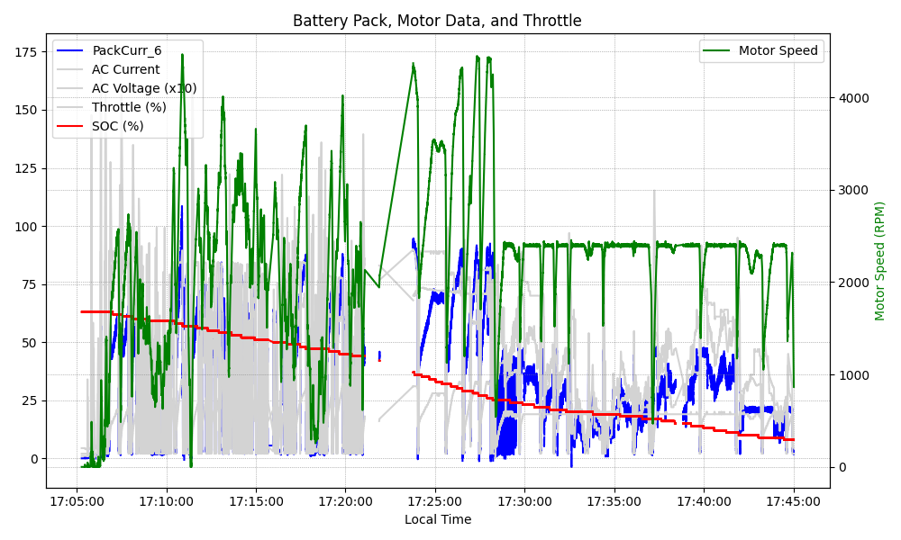
Graph Analysis

