Slide 1
Analysis Results from Folder - B4_BT04_10.45_11.45

Slide 2
Analysis Results:
Metric | Value
Total time taken for the ride | 0 days 00:47:30.489000
Actual Ampere-hours (Ah) | 28.105951944444442
Actual Watt-hours (Wh) | 1416.0317519316668
Starting SoC (Ah) | 38.841
Ending SoC (Ah) | 10.454
Starting SoC (%) | 98.0
Ending SoC (%) | 26.0
Total distance covered (km) | 31.43142949901265
Total energy consumption(WH/KM) | 45.05145882646376
Total SOC consumed(%) | 72.0
Mode | Custom mode 98.87% Eco mode 0.30% Sports mode 0.09%
Peak Power(kW) | 5437.23852
Average Power(kW) | -1800.676194614624

Slide 3
Analysis Results:
Metric | Value
Total Energy Regenerated(kWh) | 0.04504690499999999
Regenerative Effectiveness(%) | 0.0031811060697418993
Highest Cell Voltage(V) | 3.325
Lowest Cell Voltage(V) | 3.0
Difference in Cell Voltage(V) | 0.3250000000000002
Minimum Temperature(C) | 27.0
Maximum Temperature(C) | 41.0
Difference in Temperature(C) | 14.0
Maximum Fet Temperature-BMS(C) | 67.0
Maximum Afe Temperature-BMS(C) | 60.0
Maximum PCB Temperature-BMS(C) | 59.0
Maximum MCU Temperature(C) | 59.0
Maximum Motor Temperature(C) | 97.0

Slide 4
Analysis Results:
Metric | Value
Abnormal Motor Temperature Detected(C) | False
highest cell temp(C) | 41.0
lowest cell temp(C) | 27.0
Difference between Highest and Lowest Cell Temperature at 100% SOC(C) | 14.0
Battery Voltage(V) | 53.0
Total energy charged(kWh) | 1.4896154530555554
Electricity consumption units(kW) | 1.451866913309508e-07
Idling time percentage | 20.400430890382975
Time spent in 0-10 km/h | 2.841647784257643
Time spent in 10-20 km/h | 4.8252293748374875
Time spent in 20-30 km/h | 10.63482040043089
Time spent in 30-40 km/h | 10.374800341740649
Time spent in 40-50 km/h | 8.012332379926452

Slide 5
Analysis Results:
Metric | Value
Time spent in 50-60 km/h | 10.14078228891943
Time spent in 60-70 km/h | 13.669625942572713
Time spent in 70-80 km/h | 18.925745700382603
Time spent in 80-90 km/h | 0.0

Slide 6
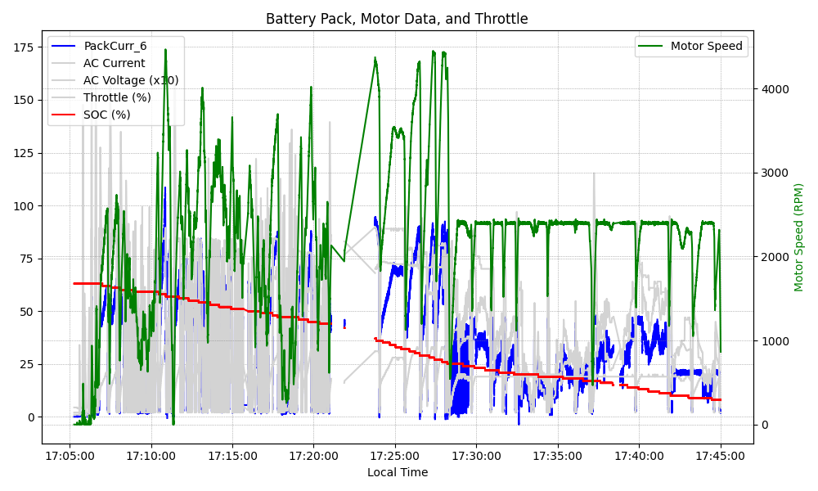
Graph Analysis

