Slide 1
Analysis Results from Folder - B4_BT04_15.52_16.57

Slide 2
Analysis Results:
Metric | Value
Total time taken for the ride | 0 days 00:51:07.590000
Actual Ampere-hours (Ah) | 32.970324166666664
Actual Watt-hours (Wh) | 1673.5433636108332
Starting SoC (Ah) | 39.268
Ending SoC (Ah) | 7.33
Starting SoC (%) | 99.0
Ending SoC (%) | 18.0
Total distance covered (km) | 30.983311756964873
Total energy consumption(WH/KM) | 54.01434736022466
Total SOC consumed(%) | 81.0
Mode | Custom mode 71.07% Eco mode 17.72% Sports mode 0.07%
Peak Power(kW) | 5421.410500000001
Average Power(kW) | -1974.6824349390363

Slide 3
Analysis Results:
Metric | Value
Total Energy Regenerated(kWh) | 1.4474072980555555
Regenerative Effectiveness(%) | 0.08641285212993494
Highest Cell Voltage(V) | 3.332
Lowest Cell Voltage(V) | 3.071
Difference in Cell Voltage(V) | 0.2609999999999997
Minimum Temperature(C) | 38.0
Maximum Temperature(C) | 48.0
Difference in Temperature(C) | 10.0
Maximum Fet Temperature-BMS(C) | 70.0
Maximum Afe Temperature-BMS(C) | 66.0
Maximum PCB Temperature-BMS(C) | 65.0
Maximum MCU Temperature(C) | 68.0
Maximum Motor Temperature(C) | 100.0

Slide 4
Analysis Results:
Metric | Value
Abnormal Motor Temperature Detected(C) | False
highest cell temp(C) | 48.0
lowest cell temp(C) | 38.0
Difference between Highest and Lowest Cell Temperature at 100% SOC(C) | 10.0
Battery Voltage(V) | 53.0
Total energy charged(kWh) | 1.7474271808333333
Electricity consumption units(kW) | 1.5826424490393557e-07
Idling time percentage | 14.057142857142857
Time spent in 0-10 km/h | 8.607142857142858
Time spent in 10-20 km/h | 3.9
Time spent in 20-30 km/h | 9.178571428571429
Time spent in 30-40 km/h | 18.15
Time spent in 40-50 km/h | 12.096428571428572

Slide 5
Analysis Results:
Metric | Value
Time spent in 50-60 km/h | 12.003571428571428
Time spent in 60-70 km/h | 14.267857142857142
Time spent in 70-80 km/h | 7.646428571428572
Time spent in 80-90 km/h | 0.0

Slide 6
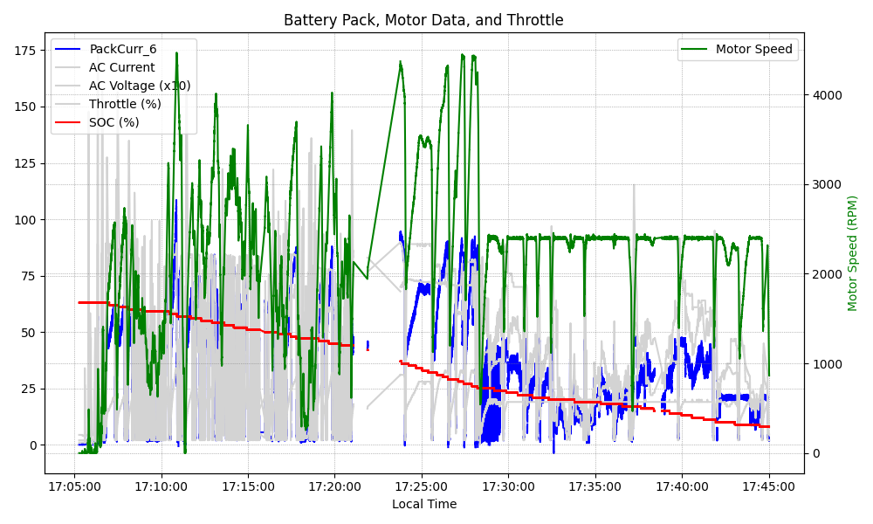
Graph Analysis

