Slide 1
Analysis Results from Folder - B4_BT05_11.47_12.42

Slide 2
Analysis Results:
Metric | Value
Total time taken for the ride | 0 days 00:45:08.460000
Actual Ampere-hours (Ah) | 27.48567361111111
Actual Watt-hours (Wh) | 1392.6852110883335
Starting SoC (Ah) | 38.734
Ending SoC (Ah) | 11.11
Starting SoC (%) | 97.0
Ending SoC (%) | 28.0
Total distance covered (km) | 28.99021316195733
Total energy consumption(WH/KM) | 48.03984031810768
Total SOC consumed(%) | 69.0
Mode | Custom mode 93.26% Eco mode 3.20% Sports mode 0.11%
Peak Power(kW) | 5527.275720000001
Average Power(kW) | -1853.4812421138633

Slide 3
Analysis Results:
Metric | Value
Total Energy Regenerated(kWh) | 0.1270907838888889
Regenerative Effectiveness(%) | 0.009124760293835223
Highest Cell Voltage(V) | 3.33
Lowest Cell Voltage(V) | 3.06
Difference in Cell Voltage(V) | 0.27
Minimum Temperature(C) | 28.0
Maximum Temperature(C) | 45.0
Difference in Temperature(C) | 17.0
Maximum Fet Temperature-BMS(C) | 70.0
Maximum Afe Temperature-BMS(C) | 67.0
Maximum PCB Temperature-BMS(C) | 66.0
Maximum MCU Temperature(C) | 64.0
Maximum Motor Temperature(C) | 102.0

Slide 4
Analysis Results:
Metric | Value
Abnormal Motor Temperature Detected(C) | False
highest cell temp(C) | 45.0
lowest cell temp(C) | 28.0
Difference between Highest and Lowest Cell Temperature at 100% SOC(C) | 17.0
Battery Voltage(V) | 53.0
Total energy charged(kWh) | 1.4567407013888887
Electricity consumption units(kW) | 1.4942769380732897e-07
Idling time percentage | 15.568719437045283
Time spent in 0-10 km/h | 5.275712638651453
Time spent in 10-20 km/h | 6.6870751003856395
Time spent in 20-30 km/h | 9.859658887607841
Time spent in 30-40 km/h | 10.797916749493103
Time spent in 40-50 km/h | 9.016817079473622

Slide 5
Analysis Results:
Metric | Value
Time spent in 50-60 km/h | 15.3142766270425
Time spent in 60-70 km/h | 14.793464000318055
Time spent in 70-80 km/h | 12.555162406074821
Time spent in 80-90 km/h | 0.0

Slide 6
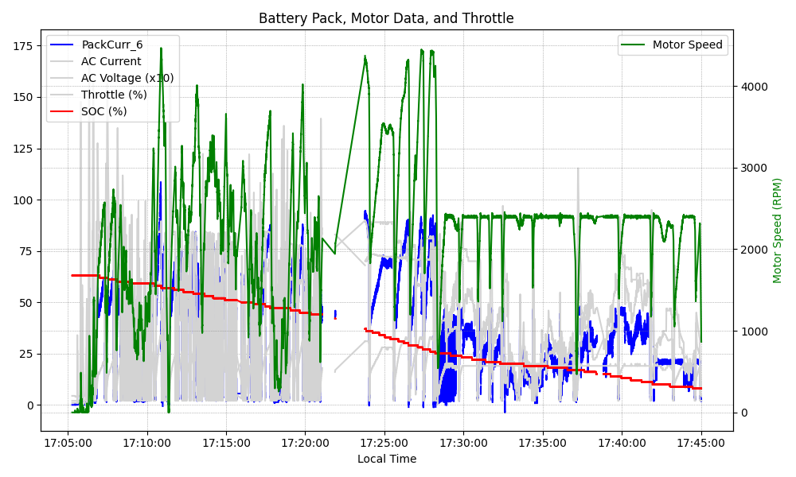
Graph Analysis

