Slide 1
Analysis Results from Folder - B4_BT06_09.00_09.55

Slide 2
Analysis Results:
Metric | Value
Total time taken for the ride | 0 days 00:48:44.036000
Actual Ampere-hours (Ah) | 27.745371666666667
Actual Watt-hours (Wh) | 1385.207483403889
Starting SoC (Ah) | 38.745
Ending SoC (Ah) | 10.26
Starting SoC (%) | 97.0
Ending SoC (%) | 25.0
Total distance covered (km) | 27.14508620657145
Total energy consumption(WH/KM) | 51.02976917673407
Total SOC consumed(%) | 72.0
Mode | Custom mode 92.78% Eco mode 6.14% Sports mode 0.07%
Peak Power(kW) | 5724.067349
Average Power(kW) | -1717.1993595915978

Slide 3
Analysis Results:
Metric | Value
Total Energy Regenerated(kWh) | 0.024432869166666666
Regenerative Effectiveness(%) | 0.0017638107294266586
Highest Cell Voltage(V) | 3.326
Lowest Cell Voltage(V) | 2.963
Difference in Cell Voltage(V) | 0.363
Minimum Temperature(C) | 25.0
Maximum Temperature(C) | 40.0
Difference in Temperature(C) | 15.0
Maximum Fet Temperature-BMS(C) | 70.0
Maximum Afe Temperature-BMS(C) | 63.0
Maximum PCB Temperature-BMS(C) | 64.0
Maximum MCU Temperature(C) | 60.0
Maximum Motor Temperature(C) | 95.0

Slide 4
Analysis Results:
Metric | Value
Abnormal Motor Temperature Detected(C) | False
highest cell temp(C) | 40.0
lowest cell temp(C) | 25.0
Difference between Highest and Lowest Cell Temperature at 100% SOC(C) | 15.0
Battery Voltage(V) | 55.0
Total energy charged(kWh) | 1.5259954416666668
Electricity consumption units(kW) | 1.4496840721107566e-07
Idling time percentage | 23.11878333573591
Time spent in 0-10 km/h | 8.433040219114892
Time spent in 10-20 km/h | 6.804093988755946
Time spent in 20-30 km/h | 7.737494594204988
Time spent in 30-40 km/h | 8.609629522848493
Time spent in 40-50 km/h | 11.993657200518957

Slide 5
Analysis Results:
Metric | Value
Time spent in 50-60 km/h | 8.353755225601846
Time spent in 60-70 km/h | 13.139685743116623
Time spent in 70-80 km/h | 11.662101773100764
Time spent in 80-90 km/h | 0.0

Slide 6
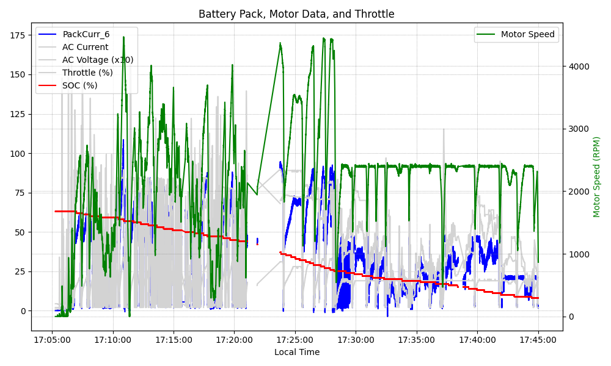
Graph Analysis

