Slide 1
Analysis Results from Folder - B4_B05_13.50_14.48

Slide 2
Analysis Results:
Metric | Value
Total time taken for the ride | 0 days 00:59:13.514000
Actual Ampere-hours (Ah) | 32.94080611111111
Actual Watt-hours (Wh) | 1687.9569241230554
Starting SoC (Ah) | 7.847
Ending SoC (Ah) | 8.059
Starting SoC (%) | 99.0
Ending SoC (%) | 19.0
Total distance covered (km) | 40.8186656019447
Total energy consumption(WH/KM) | 41.35257483876781
Total SOC consumed(%) | 80.0
Mode | Custom mode 58.33% Eco mode 34.81%
Peak Power(kW) | 4493.966352
Average Power(kW) | -1722.4050246153627

Slide 3
Analysis Results:
Metric | Value
Total Energy Regenerated(kWh) | 0.18428819249999998
Regenerative Effectiveness(%) | 0.010916633700756542
Highest Cell Voltage(V) | 3.377
Lowest Cell Voltage(V) | 3.112
Difference in Cell Voltage(V) | 0.2649999999999997
Minimum Temperature(C) | 36.0
Maximum Temperature(C) | 49.0
Difference in Temperature(C) | 13.0
Maximum Fet Temperature-BMS(C) | 68.0
Maximum Afe Temperature-BMS(C) | 68.0
Maximum PCB Temperature-BMS(C) | 66.0
Maximum MCU Temperature(C) | 51.0
Maximum Motor Temperature(C) | 100.0

Slide 4
Analysis Results:
Metric | Value
Abnormal Motor Temperature Detected(C) | False
highest cell temp(C) | 49.0
lowest cell temp(C) | 36.0
Difference between Highest and Lowest Cell Temperature at 100% SOC(C) | 13.0
Battery Voltage(V) | 53.0
Total energy charged(kWh) | 1.7458627238888886
Electricity consumption units(kW) | 1.3649363010045412e-07
Idling time percentage | 5.028353018578277
Time spent in 0-10 km/h | 6.814123249475235
Time spent in 10-20 km/h | 3.2707791597481126
Time spent in 20-30 km/h | 7.399981202418622
Time spent in 30-40 km/h | 27.09358062595946
Time spent in 40-50 km/h | 4.007017763714402

Slide 5
Analysis Results:
Metric | Value
Time spent in 50-60 km/h | 32.212788621197404
Time spent in 60-70 km/h | 14.041793289263449
Time spent in 70-80 km/h | 0.0
Time spent in 80-90 km/h | 0.0

Slide 6
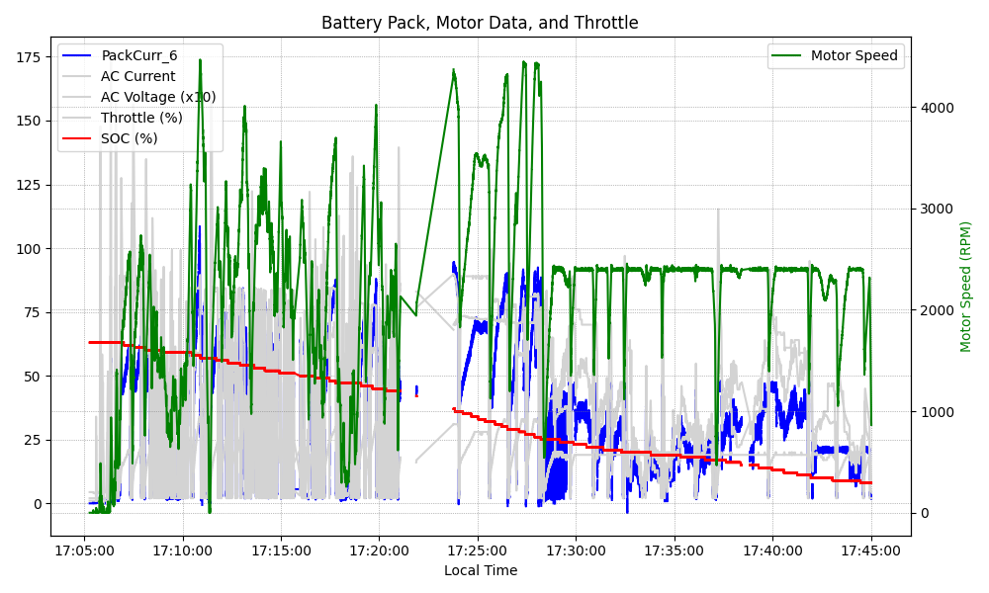
Graph Analysis

