Slide 1
Analysis Results from Folder - B3_B03_13.15_15.30

Slide 2
Analysis Results:
Metric | Value
Total time taken for the ride | 0 days 02:09:31.852000
Actual Ampere-hours (Ah) | 35.05374861111112
Actual Watt-hours (Wh) | 1804.831415305278
Starting SoC (Ah) | 38.646
Ending SoC (Ah) | 3.902
Starting SoC (%) | 97.0
Ending SoC (%) | 9.0
Total distance covered (km) | 67.44375803705395
Total energy consumption(WH/KM) | 26.760540453776226
Total SOC consumed(%) | 88.0
Mode | Eco mode 100.00%
Peak Power(kW) | 2438.510646
Average Power(kW) | -839.3480293371658

Slide 3
Analysis Results:
Metric | Value
Total Energy Regenerated(kWh) | 19.54605749888889
Regenerative Effectiveness(%) | 1.0713823093225079
Highest Cell Voltage(V) | 3.339
Lowest Cell Voltage(V) | 3.024
Difference in Cell Voltage(V) | 0.31499999999999995
Minimum Temperature(C) | 23.0
Maximum Temperature(C) | 44.0
Difference in Temperature(C) | 21.0
Maximum Fet Temperature-BMS(C) | 58.0
Maximum Afe Temperature-BMS(C) | 62.0
Maximum PCB Temperature-BMS(C) | 57.0
Maximum MCU Temperature(C) | 42.0
Maximum Motor Temperature(C) | 0.0

Slide 4
Analysis Results:
Metric | Value
Abnormal Motor Temperature Detected(C) | False
highest cell temp(C) | 44.0
lowest cell temp(C) | 0.0
Difference between Highest and Lowest Cell Temperature at 100% SOC(C) | 44.0
Battery Voltage(V) | 55.0
Total energy charged(kWh) | 1.9279561736111115
Electricity consumption units(kW) | 6.891563268030396e-08
Idling time percentage | 18.101378510345572
Time spent in 0-10 km/h | 3.6256710458873993
Time spent in 10-20 km/h | 1.7548355768971378
Time spent in 20-30 km/h | 2.947206560738083
Time spent in 30-40 km/h | 41.9757749062559
Time spent in 40-50 km/h | 29.219833283876017

Slide 5
Analysis Results:
Metric | Value
Time spent in 50-60 km/h | 0.0
Time spent in 60-70 km/h | 0.0
Time spent in 70-80 km/h | 0.0
Time spent in 80-90 km/h | 0.0

Slide 6
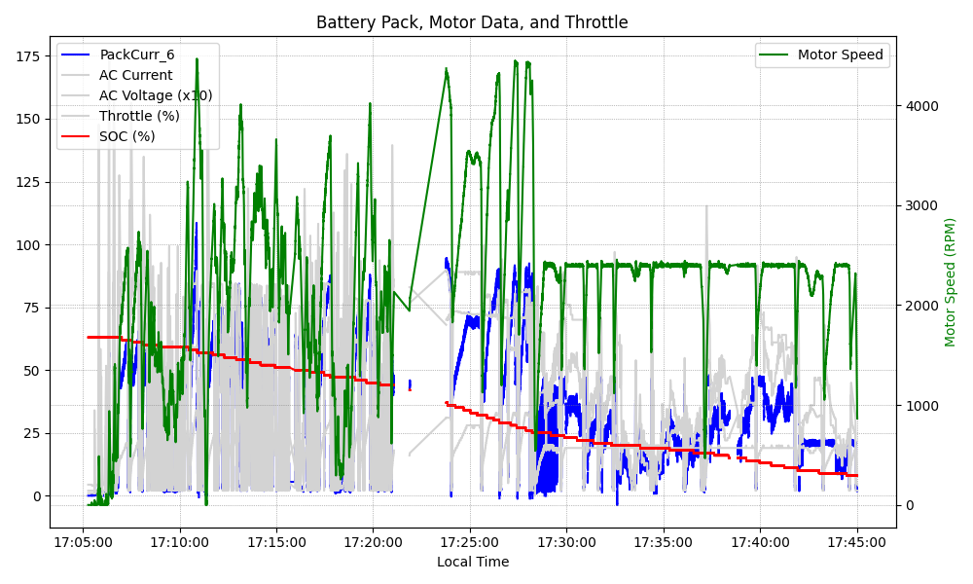
Graph Analysis

