Slide 1
Analysis Results from Folder - Battery_8

Slide 2
Analysis Results:
Metric | Value
Date and Time | 13/03/2024 17:52:00 to 13/03/2024 19:35:59
Byte Beam ID | 3
Total time taken for the ride | 0 days 01:43:59.938000
Actual Ampere-hours (Ah) | 24.692250833333333
Actual Watt-hours (Wh)- Calculated_UsingFormala | 1284.3934288883333
Starting SoC (Ah) | 12.359
Ending SoC (Ah) | 36.943
Starting SoC (%) | 93.0
Ending SoC (%) | 31.0
Total distance covered (km) | 50.52086283354855
Total energy consumption(WH/KM) | 25.423030345305733
Total SOC consumed(%) | 62.0
Mode | Eco mode 98.07% Sports mode 0.40%

Slide 3
Analysis Results:
Metric | Value
Peak Power(kW) | 2679.67035
Average Power(kW) | 745.7768296770968
Total Energy Regenerated(kWh) | 85.10187806638889
Regenerative Effectiveness(%) | 6.214105125750715
Highest Cell Voltage(V) | 3.378
Lowest Cell Voltage(V) | 3.173
Difference in Cell Voltage(V) | 0.20500000000000007
Minimum Temperature(C) | 33.0
Maximum Temperature(C) | 36.0
Difference in Temperature(C) | 3.0
Maximum Fet Temperature-BMS(C) | 45.0
Maximum Afe Temperature-BMS(C) | 48.0
Maximum PCB Temperature-BMS(C) | 45.0

Slide 4
Analysis Results:
Metric | Value
Maximum MCU Temperature(C) | 41.0
Maximum Motor Temperature(C) | 0.0
Abnormal Motor Temperature Detected(C) | False
highest cell temp(C) | 36.0
lowest cell temp(C) | 33.0
Difference between Highest and Lowest Cell Temperature at 100% SOC(C) | 3.0
Battery Voltage(V) | 55.0
Total energy charged(kWh)- Calculated_BatteryData | 1.3580737958333333
Electricity consumption units(kW) | 6.046525421779369e-08
Cycle Count of battery | 139.0
Idling time percentage | 5.986564916496049
Time spent in 0-10 km/h | 11.922367552750469
Time spent in 10-20 km/h | 8.32162980761096

Slide 5
Analysis Results:
Metric | Value
Time spent in 20-30 km/h | 12.389380530973451
Time spent in 30-40 km/h | 39.301849439076804
Time spent in 40-50 km/h | 20.162777711974822
Time spent in 50-60 km/h | 0.0
Time spent in 60-70 km/h | 0.0
Time spent in 70-80 km/h | 0.0
Time spent in 80-90 km/h | 0.0

Slide 6
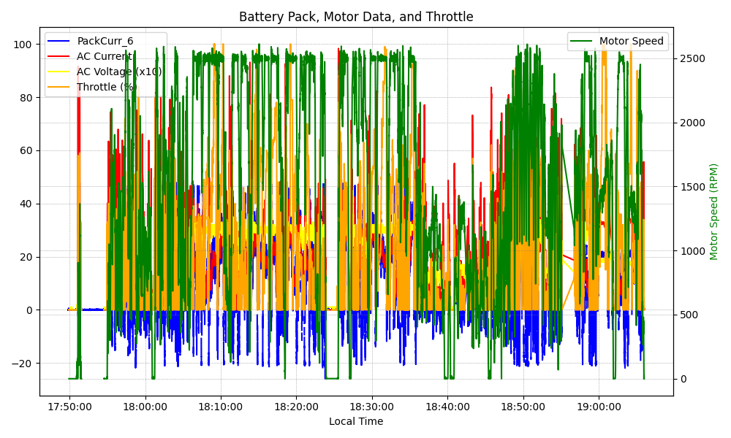
Graph Analysis

