Slide 1
Analysis Results from Folder - Battery_1

Slide 2
Analysis Results:
Metric | Value
Date and Time | 13/03/2024 06:20:34 to 13/03/2024 08:31:23
Byte Beam ID | 3
Total time taken for the ride | 0 days 02:10:49.318000
Actual Ampere-hours (Ah) | 35.87846583333333
Actual Watt-hours (Wh)- Calculated_UsingFormala | 1843.8959268033334
Starting SoC (Ah) | 3.757
Ending SoC (Ah) | 39.574
Starting SoC (%) | 99.0
Ending SoC (%) | 0.0
Total distance covered (km) | 63.440222411896464
Total energy consumption(WH/KM) | 29.065092408275692
Total SOC consumed(%) | 99.0
Mode | Eco mode 99.76% Sports mode 0.01%

Slide 3
Analysis Results:
Metric | Value
Peak Power(kW) | 2525.98787
Average Power(kW) | 849.7216252549923
Total Energy Regenerated(kWh) | 111.11560017250001
Regenerative Effectiveness(%) | 5.683628901379544
Highest Cell Voltage(V) | 3.459
Lowest Cell Voltage(V) | 2.838
Difference in Cell Voltage(V) | 0.621
Minimum Temperature(C) | 27.0
Maximum Temperature(C) | 39.0
Difference in Temperature(C) | 12.0
Maximum Fet Temperature-BMS(C) | 55.0
Maximum Afe Temperature-BMS(C) | 60.0
Maximum PCB Temperature-BMS(C) | 54.0

Slide 4
Analysis Results:
Metric | Value
Maximum MCU Temperature(C) | 35.0
Maximum Motor Temperature(C) | 0.0
Abnormal Motor Temperature Detected(C) | False
highest cell temp(C) | 39.0
lowest cell temp(C) | 27.0
Difference between Highest and Lowest Cell Temperature at 100% SOC(C) | 12.0
Battery Voltage(V) | 56.0
Total energy charged(kWh)- Calculated_BatteryData | 2.009194086666666
Electricity consumption units(kW) | 7.110580564639041e-08
Cycle Count of battery | 78.0
Idling time percentage | 7.828772819071002
Time spent in 0-10 km/h | 7.861772198682665
Time spent in 10-20 km/h | 9.626579020314418

Slide 5
Analysis Results:
Metric | Value
Time spent in 20-30 km/h | 15.158595018413653
Time spent in 30-40 km/h | 41.60429783920062
Time spent in 40-50 km/h | 16.660726778336567
Time spent in 50-60 km/h | 0.0
Time spent in 60-70 km/h | 0.0
Time spent in 70-80 km/h | 0.0
Time spent in 80-90 km/h | 0.0

Slide 6
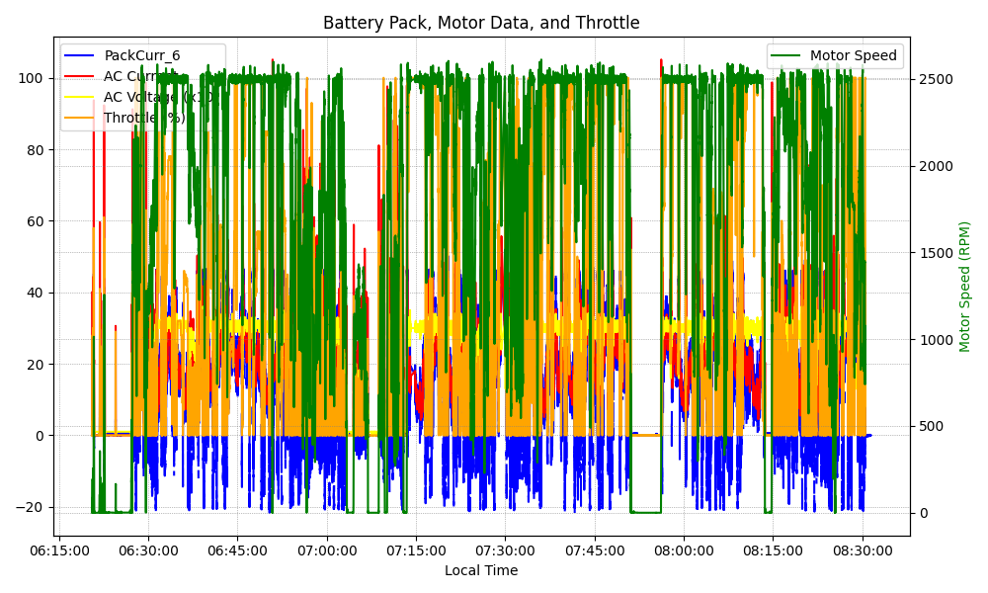
Graph Analysis

