Slide 1
Analysis Results from Folder - Battery_8

Slide 2
Analysis Results:
Metric | Value
Date and Time | 13/03/2024 17:51:00 to 13/03/2024 19:36:59
Byte Beam ID | 3
Total time taken for the ride | 0 days 01:45:59.265000
Actual Ampere-hours (Ah) | 24.745355555555555
Actual Watt-hours (Wh)- Calculated_UsingFormala | 1287.1455766961112
Starting SoC (Ah) | 12.314
Ending SoC (Ah) | 36.943
Starting SoC (%) | 93.0
Ending SoC (%) | 31.0
Total distance covered (km) | 50.572806378306794
Total energy consumption(WH/KM) | 25.4513377617943
Total SOC consumed(%) | 62.0
Mode | Eco mode 98.09% Sports mode 0.40%

Slide 3
Analysis Results:
Metric | Value
Peak Power(kW) | 2679.67035
Average Power(kW) | 733.300217772749
Total Energy Regenerated(kWh) | 85.24831516583333
Regenerative Effectiveness(%) | 6.2116507273415404
Highest Cell Voltage(V) | 3.378
Lowest Cell Voltage(V) | 3.173
Difference in Cell Voltage(V) | 0.20500000000000007
Minimum Temperature(C) | 33.0
Maximum Temperature(C) | 36.0
Difference in Temperature(C) | 3.0
Maximum Fet Temperature-BMS(C) | 45.0
Maximum Afe Temperature-BMS(C) | 48.0
Maximum PCB Temperature-BMS(C) | 45.0

Slide 4
Analysis Results:
Metric | Value
Maximum MCU Temperature(C) | 41.0
Maximum Motor Temperature(C) | 0.0
Abnormal Motor Temperature Detected(C) | False
highest cell temp(C) | 36.0
lowest cell temp(C) | 33.0
Difference between Highest and Lowest Cell Temperature at 100% SOC(C) | 3.0
Battery Voltage(V) | 55.0
Total energy charged(kWh)- Calculated_BatteryData | 1.3609945555555556
Electricity consumption units(kW) | 5.945180739265239e-08
Cycle Count of battery | 139.0
Idling time percentage | 7.071058917197452
Time spent in 0-10 km/h | 12.415406050955415
Time spent in 10-20 km/h | 8.197319532908704

Slide 5
Analysis Results:
Metric | Value
Time spent in 20-30 km/h | 12.145037154989383
Time spent in 30-40 km/h | 38.52673832271763
Time spent in 40-50 km/h | 19.76512738853503
Time spent in 50-60 km/h | 0.0
Time spent in 60-70 km/h | 0.0
Time spent in 70-80 km/h | 0.0
Time spent in 80-90 km/h | 0.0

Slide 6
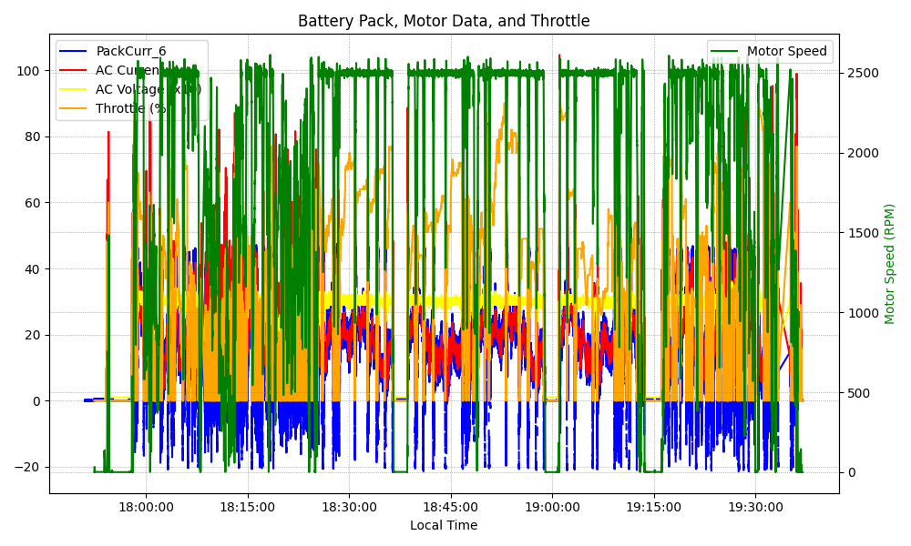
Graph Analysis

