Slide 1
Analysis Results from Folder - Battery_2

Slide 2
Analysis Results:
Metric | Value
Date and Time | 14/03/2024 16:50:32 to 14/03/2024 19:06:36
Byte Beam ID | 3
Total time taken for the ride | 0 days 02:16:03.719000
Actual Ampere-hours (Ah) | 15.403262222222223
Actual Watt-hours (Wh)- Calculated_UsingFormala | 789.978947631111
Starting SoC (Ah) | 2.934
Ending SoC (Ah) | 3.304
Starting SoC (%) | 48.0
Ending SoC (%) | 7.0
Total distance covered (km) | 29.814149386249447
Total energy consumption(WH/KM) | 26.496779679901127
Total SOC consumed(%) | 41.0
Mode | Eco mode 99.35%

Slide 3
Analysis Results:
Metric | Value
Peak Power(kW) | 2518.2951709999998
Average Power(kW) | 349.1191028077584
Total Energy Regenerated(kWh) | 98.09523615722223
Regenerative Effectiveness(%) | 11.04583805586703
Highest Cell Voltage(V) | 3.318
Lowest Cell Voltage(V) | 3.099
Difference in Cell Voltage(V) | 0.21899999999999986
Minimum Temperature(C) | 41.0
Maximum Temperature(C) | 45.0
Difference in Temperature(C) | 4.0
Maximum Fet Temperature-BMS(C) | 49.0
Maximum Afe Temperature-BMS(C) | 52.0
Maximum PCB Temperature-BMS(C) | 50.0

Slide 4
Analysis Results:
Metric | Value
Maximum MCU Temperature(C) | 44.0
Maximum Motor Temperature(C) | 0.0
Abnormal Motor Temperature Detected(C) | False
highest cell temp(C) | 45.0
lowest cell temp(C) | 41.0
Difference between Highest and Lowest Cell Temperature at 100% SOC(C) | 4.0
Battery Voltage(V) | 54.0
Total energy charged(kWh)- Calculated_BatteryData | 0.83177616
Electricity consumption units(kW) | 2.83044142267957e-08
Cycle Count of battery | 46.0
Idling time percentage | 7.102979916378664
Time spent in 0-10 km/h | 13.821688377601083
Time spent in 10-20 km/h | 20.144041375643475

Slide 5
Analysis Results:
Metric | Value
Time spent in 20-30 km/h | 19.373081663726225
Time spent in 30-40 km/h | 28.87594557362786
Time spent in 40-50 km/h | 9.838799332962758
Time spent in 50-60 km/h | 0.0
Time spent in 60-70 km/h | 0.0
Time spent in 70-80 km/h | 0.0
Time spent in 80-90 km/h | 0.0

Slide 6
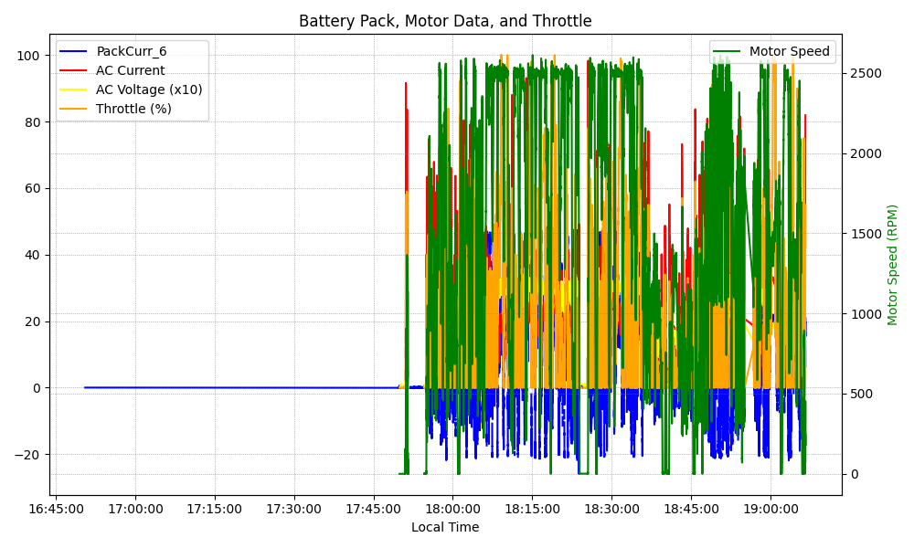
Graph Analysis

