Slide 1
Analysis Results from Folder - Battery_1

Slide 2
Analysis Results:
Metric | Value
Date and Time | 15/03/2024 13:05:28 to 15/03/2024 15:08:15
Byte Beam ID | 3
Total time taken for the ride | 0 days 02:02:47.053000
Actual Ampere-hours (Ah) | 36.38166694444445
Actual Watt-hours (Wh)- Calculated_UsingFormala | 1873.7228463200001
Starting SoC (Ah) | 3.102
Ending SoC (Ah) | 39.274
Starting SoC (%) | 99.0
Ending SoC (%) | 7.0
Total distance covered (km) | 61.849425552444686
Total energy consumption(WH/KM) | 30.29491106156181
Total SOC consumed(%) | 92.0
Mode | Eco mode 99.97%

Slide 3
Analysis Results:
Metric | Value
Peak Power(kW) | 2486.930292
Average Power(kW) | 919.4932179323882
Total Energy Regenerated(kWh) | 93.06660897972222
Regenerative Effectiveness(%) | 4.731905020587964
Highest Cell Voltage(V) | 3.377
Lowest Cell Voltage(V) | 3.087
Difference in Cell Voltage(V) | 0.2899999999999996
Minimum Temperature(C) | 30.0
Maximum Temperature(C) | 41.0
Difference in Temperature(C) | 11.0
Maximum Fet Temperature-BMS(C) | 47.0
Maximum Afe Temperature-BMS(C) | 50.0
Maximum PCB Temperature-BMS(C) | 47.0

Slide 4
Analysis Results:
Metric | Value
Maximum MCU Temperature(C) | 43.0
Maximum Motor Temperature(C) | 0.0
Abnormal Motor Temperature Detected(C) | False
highest cell temp(C) | 41.0
lowest cell temp(C) | 30.0
Difference between Highest and Lowest Cell Temperature at 100% SOC(C) | 11.0
Battery Voltage(V) | 55.0
Total energy charged(kWh)- Calculated_BatteryData | 2.0009916819444444
Electricity consumption units(kW) | 7.544876106452364e-08
Cycle Count of battery | 47.0
Idling time percentage | 14.594896191231316
Time spent in 0-10 km/h | 4.846856370951165
Time spent in 10-20 km/h | 3.918891140281326

Slide 5
Analysis Results:
Metric | Value
Time spent in 20-30 km/h | 8.240096320441664
Time spent in 30-40 km/h | 45.153143629048834
Time spent in 40-50 km/h | 21.679440871582536
Time spent in 50-60 km/h | 0.0
Time spent in 60-70 km/h | 0.0
Time spent in 70-80 km/h | 0.0
Time spent in 80-90 km/h | 0.0

Slide 6
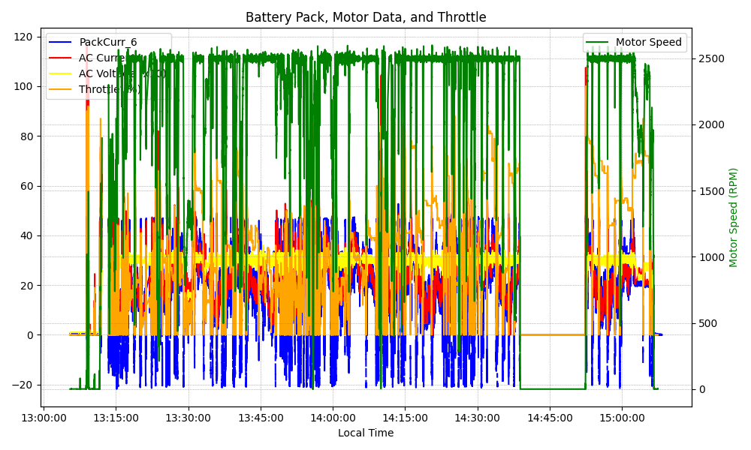
Graph Analysis

