Slide 1
Analysis Results from Folder - Battery_2

Slide 2
Analysis Results:
Metric | Value
Date and Time | 15/03/2024 15:09:50 to 15/03/2024 17:23:42
Byte Beam ID | 3
Total time taken for the ride | 0 days 02:13:51.637000
Actual Ampere-hours (Ah) | 32.621251111111114
Actual Watt-hours (Wh)- Calculated_UsingFormala | 1680.2635746130554
Starting SoC (Ah) | 3.987
Ending SoC (Ah) | 38.772
Starting SoC (%) | 97.0
Ending SoC (%) | 10.0
Total distance covered (km) | 57.772901129836455
Total energy consumption(WH/KM) | 29.083939732174773
Total SOC consumed(%) | 87.0
Mode | Eco mode 100.00%

Slide 3
Analysis Results:
Metric | Value
Peak Power(kW) | 2579.872878
Average Power(kW) | 757.5389941899812
Total Energy Regenerated(kWh) | 132.7408764213889
Regenerative Effectiveness(%) | 7.321596830369118
Highest Cell Voltage(V) | 3.339
Lowest Cell Voltage(V) | 3.051
Difference in Cell Voltage(V) | 0.2879999999999998
Minimum Temperature(C) | 33.0
Maximum Temperature(C) | 44.0
Difference in Temperature(C) | 11.0
Maximum Fet Temperature-BMS(C) | 58.0
Maximum Afe Temperature-BMS(C) | 60.0
Maximum PCB Temperature-BMS(C) | 58.0

Slide 4
Analysis Results:
Metric | Value
Maximum MCU Temperature(C) | 45.0
Maximum Motor Temperature(C) | 0.0
Abnormal Motor Temperature Detected(C) | False
highest cell temp(C) | 44.0
lowest cell temp(C) | 33.0
Difference between Highest and Lowest Cell Temperature at 100% SOC(C) | 11.0
Battery Voltage(V) | 55.0
Total energy charged(kWh)- Calculated_BatteryData | 1.7941688111111114
Electricity consumption units(kW) | 6.20570570674439e-08
Cycle Count of battery | 118.0
Idling time percentage | 21.797872489523623
Time spent in 0-10 km/h | 6.395145127608583
Time spent in 10-20 km/h | 4.385362503678995

Slide 5
Analysis Results:
Metric | Value
Time spent in 20-30 km/h | 9.100082689801123
Time spent in 30-40 km/h | 39.35473924682205
Time spent in 40-50 km/h | 17.62273829378705
Time spent in 50-60 km/h | 0.0
Time spent in 60-70 km/h | 0.0
Time spent in 70-80 km/h | 0.0
Time spent in 80-90 km/h | 0.0

Slide 6
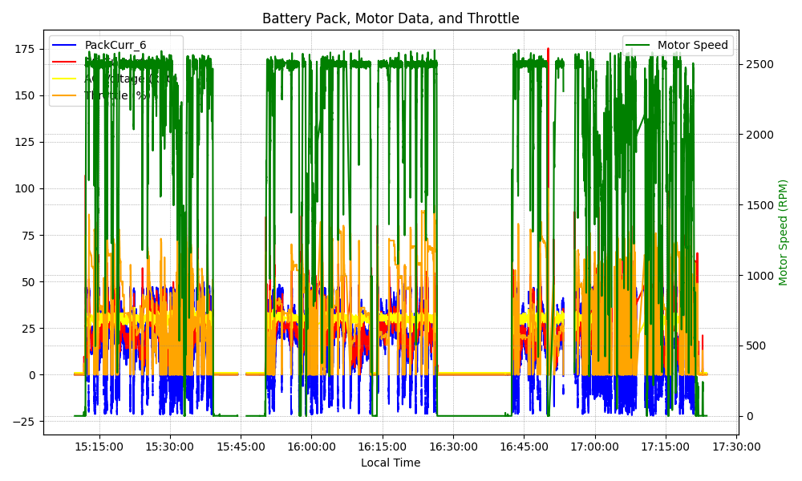
Graph Analysis

