Slide 1
Analysis Results from Folder - Battery_3

Slide 2
Analysis Results:
Metric | Value
Date and Time | 15/03/2024 17:28:12 to 15/03/2024 19:57:47
Byte Beam ID | 3
Total time taken for the ride | 0 days 02:29:35.290000
Actual Ampere-hours (Ah) | 33.81874416666666
Actual Watt-hours (Wh)- Calculated_UsingFormala | 1749.3806594066668
Starting SoC (Ah) | 6.918
Ending SoC (Ah) | 39.56
Starting SoC (%) | 99.0
Ending SoC (%) | 17.0
Total distance covered (km) | 59.6764692133722
Total energy consumption(WH/KM) | 29.31441290790489
Total SOC consumed(%) | 82.0
Mode | Eco mode 91.36% Sports mode 3.47% Custom mode 0.01%

Slide 3
Analysis Results:
Metric | Value
Peak Power(kW) | 5097.477871
Average Power(kW) | 706.1864065781566
Total Energy Regenerated(kWh) | 116.53721974444444
Regenerative Effectiveness(%) | 6.245570667743555
Highest Cell Voltage(V) | 3.471
Lowest Cell Voltage(V) | 3.088
Difference in Cell Voltage(V) | 0.383
Minimum Temperature(C) | 30.0
Maximum Temperature(C) | 39.0
Difference in Temperature(C) | 9.0
Maximum Fet Temperature-BMS(C) | 48.0
Maximum Afe Temperature-BMS(C) | 52.0
Maximum PCB Temperature-BMS(C) | 49.0

Slide 4
Analysis Results:
Metric | Value
Maximum MCU Temperature(C) | 43.0
Maximum Motor Temperature(C) | 0.0
Abnormal Motor Temperature Detected(C) | False
highest cell temp(C) | 39.0
lowest cell temp(C) | 21.0
Difference between Highest and Lowest Cell Temperature at 100% SOC(C) | 18.0
Battery Voltage(V) | 59.0
Total energy charged(kWh)- Calculated_BatteryData | 1.9953059058333331
Electricity consumption units(kW) | 6.175505743835757e-08
Cycle Count of battery | 80.0
Idling time percentage | 10.368199540396086
Time spent in 0-10 km/h | 11.34421234733662
Time spent in 10-20 km/h | 15.700121356089753

Slide 5
Analysis Results:
Metric | Value
Time spent in 20-30 km/h | 17.33068243435152
Time spent in 30-40 km/h | 32.172274006558396
Time spent in 40-50 km/h | 11.849002039815124
Time spent in 50-60 km/h | 0.3072632910738723
Time spent in 60-70 km/h | 0.0
Time spent in 70-80 km/h | 0.0
Time spent in 80-90 km/h | 0.0

Slide 6
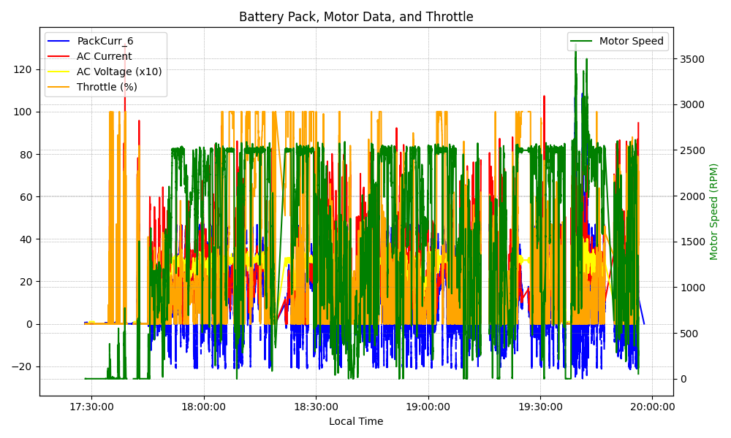
Graph Analysis

