Slide 1
Analysis Results from Folder - Battery_4

Slide 2
Analysis Results:
Metric | Value
Date and Time | 15/03/2024 19:57:47 to 15/03/2024 21:32:42
Byte Beam ID | 3
Total time taken for the ride | 0 days 01:34:55.205000
Actual Ampere-hours (Ah) | 23.897325833333337
Actual Watt-hours (Wh)- Calculated_UsingFormala | 1243.7172890466666
Starting SoC (Ah) | 15.451
Ending SoC (Ah) | 6.918
Starting SoC (%) | 99.0
Ending SoC (%) | 17.0
Total distance covered (km) | 40.32880311624646
Total energy consumption(WH/KM) | 30.83942971135771
Total SOC consumed(%) | 82.0
Mode | Sports mode 74.78% Eco mode 16.95% Custom mode 0.77%

Slide 3
Analysis Results:
Metric | Value
Peak Power(kW) | 5829.929448
Average Power(kW) | 790.0798024647962
Total Energy Regenerated(kWh) | 59.737750964166665
Regenerative Effectiveness(%) | 4.583031184847785
Highest Cell Voltage(V) | 3.425
Lowest Cell Voltage(V) | 3.135
Difference in Cell Voltage(V) | 0.29000000000000004
Minimum Temperature(C) | 37.0
Maximum Temperature(C) | 43.0
Difference in Temperature(C) | 6.0
Maximum Fet Temperature-BMS(C) | 50.0
Maximum Afe Temperature-BMS(C) | 51.0
Maximum PCB Temperature-BMS(C) | 49.0

Slide 4
Analysis Results:
Metric | Value
Maximum MCU Temperature(C) | 43.0
Maximum Motor Temperature(C) | 0.0
Abnormal Motor Temperature Detected(C) | False
highest cell temp(C) | 43.0
lowest cell temp(C) | 37.0
Difference between Highest and Lowest Cell Temperature at 100% SOC(C) | 6.0
Battery Voltage(V) | 56.0
Total energy charged(kWh)- Calculated_BatteryData | 1.338250246666667
Electricity consumption units(kW) | 6.527413162943454e-08
Cycle Count of battery | 118.0
Idling time percentage | 13.25895453272739
Time spent in 0-10 km/h | 5.9165607702082745
Time spent in 10-20 km/h | 9.901139374098085

Slide 5
Analysis Results:
Metric | Value
Time spent in 20-30 km/h | 25.423765319089362
Time spent in 30-40 km/h | 27.971741799306464
Time spent in 40-50 km/h | 15.115552779512806
Time spent in 50-60 km/h | 2.2249025393611754
Time spent in 60-70 km/h | 0.006461478817118611
Time spent in 70-80 km/h | 0.0
Time spent in 80-90 km/h | 0.0

Slide 6
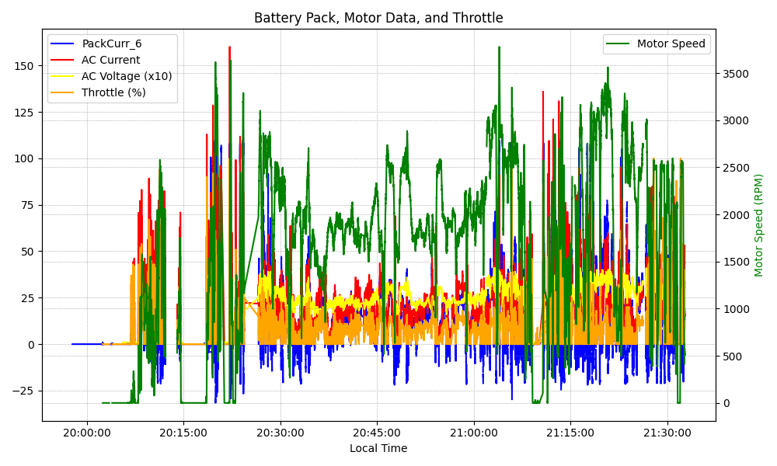
Graph Analysis

