Slide 1
Analysis Results from Folder - Battery_1

Slide 2
Analysis Results:
Metric | Value
Date and Time | 16/03/2024 06:46:51 to 16/03/2024 07:14:58
Byte Beam ID | 3
Total time taken for the ride | 0 days 00:28:06.379000
Actual Ampere-hours (Ah) | 22.90996555555555
Actual Watt-hours (Wh)- Calculated_UsingFormala | 1156.8404710238888
Starting SoC (Ah) | 10.349
Ending SoC (Ah) | 34.345
Starting SoC (%) | 86.0
Ending SoC (%) | 26.0
Total distance covered (km) | 20.561933213585213
Total energy consumption(WH/KM) | 56.26126974576337
Total SOC consumed(%) | 60.0
Mode | Custom mode 91.31% Eco mode 0.89% Sports mode 0.12%

Slide 3
Analysis Results:
Metric | Value
Peak Power(kW) | 6200.638545000001
Average Power(kW) | 2478.9438664797617
Total Energy Regenerated(kWh) | 36.82113403444444
Regenerative Effectiveness(%) | 3.0847213212194275
Highest Cell Voltage(V) | 3.339
Lowest Cell Voltage(V) | 3.064
Difference in Cell Voltage(V) | 0.2749999999999999
Minimum Temperature(C) | 28.0
Maximum Temperature(C) | 40.0
Difference in Temperature(C) | 12.0
Maximum Fet Temperature-BMS(C) | 71.0
Maximum Afe Temperature-BMS(C) | 67.0
Maximum PCB Temperature-BMS(C) | 64.0

Slide 4
Analysis Results:
Metric | Value
Maximum MCU Temperature(C) | 43.0
Maximum Motor Temperature(C) | 0.0
Abnormal Motor Temperature Detected(C) | True
highest cell temp(C) | 40.0
lowest cell temp(C) | 28.0
Difference between Highest and Lowest Cell Temperature at 100% SOC(C) | 12.0
Battery Voltage(V) | 55.0
Total energy charged(kWh)- Calculated_BatteryData | 1.2600481055555555
Electricity consumption units(kW) | 2.075998592255759e-07
Cycle Count of battery | 33.0
Idling time percentage | 6.455366922234392
Time spent in 0-10 km/h | 4.990416210295728
Time spent in 10-20 km/h | 2.4370208105147864

Slide 5
Analysis Results:
Metric | Value
Time spent in 20-30 km/h | 5.894030668127054
Time spent in 30-40 km/h | 8.467962760131435
Time spent in 40-50 km/h | 9.166210295728368
Time spent in 50-60 km/h | 28.682913472070098
Time spent in 60-70 km/h | 22.590361445783135
Time spent in 70-80 km/h | 7.8381708652793
Time spent in 80-90 km/h | 3.313253012048193

Slide 6
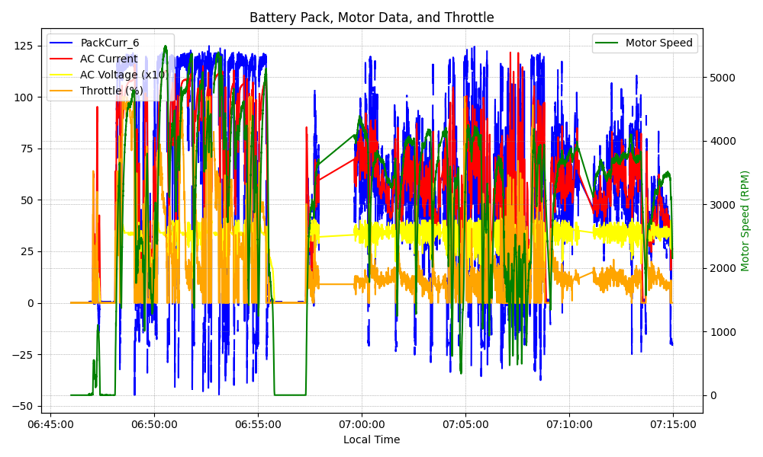
Graph Analysis

