Slide 1
Analysis Results from Folder - Battery_10

Slide 2
Analysis Results:
Metric | Value
Date and Time | 16/03/2024 19:29:00 to 16/03/2024 21:03:33
Byte Beam ID | 3
Total time taken for the ride | 0 days 01:34:32.976000
Actual Ampere-hours (Ah) | 34.377095
Actual Watt-hours (Wh)- Calculated_UsingFormala | 1756.620552649722
Starting SoC (Ah) | 5.462
Ending SoC (Ah) | 36.705
Starting SoC (%) | 100.0
Ending SoC (%) | 13.0
Total distance covered (km) | 49.8105195649899
Total energy consumption(WH/KM) | 35.26605560413367
Total SOC consumed(%) | 87.0
Mode | Sports mode 73.62% Eco mode 24.61%

Slide 3
Analysis Results:
Metric | Value
Peak Power(kW) | 5607.9944350000005
Average Power(kW) | 1122.6405094157642
Total Energy Regenerated(kWh) | 120.84187927750001
Regenerative Effectiveness(%) | 6.436447261075438
Highest Cell Voltage(V) | 3.515
Lowest Cell Voltage(V) | 3.052
Difference in Cell Voltage(V) | 0.4630000000000001
Minimum Temperature(C) | 31.0
Maximum Temperature(C) | 45.0
Difference in Temperature(C) | 14.0
Maximum Fet Temperature-BMS(C) | 70.0
Maximum Afe Temperature-BMS(C) | 68.0
Maximum PCB Temperature-BMS(C) | 64.0

Slide 4
Analysis Results:
Metric | Value
Maximum MCU Temperature(C) | 49.0
Maximum Motor Temperature(C) | 0.0
Abnormal Motor Temperature Detected(C) | False
highest cell temp(C) | 45.0
lowest cell temp(C) | 31.0
Difference between Highest and Lowest Cell Temperature at 100% SOC(C) | 14.0
Battery Voltage(V) | 56.0
Total energy charged(kWh)- Calculated_BatteryData | 1.9251173199999998
Electricity consumption units(kW) | 9.427976218461054e-08
Cycle Count of battery | 142.0
Idling time percentage | 19.504607387571866
Time spent in 0-10 km/h | 5.0051193195242965
Time spent in 10-20 km/h | 9.523903284240372

Slide 5
Analysis Results:
Metric | Value
Time spent in 20-30 km/h | 10.153973379538474
Time spent in 30-40 km/h | 17.8053870993148
Time spent in 40-50 km/h | 18.47680554461684
Time spent in 50-60 km/h | 10.957312751043553
Time spent in 60-70 km/h | 8.080648972198157
Time spent in 70-80 km/h | 0.0
Time spent in 80-90 km/h | 0.0

Slide 6
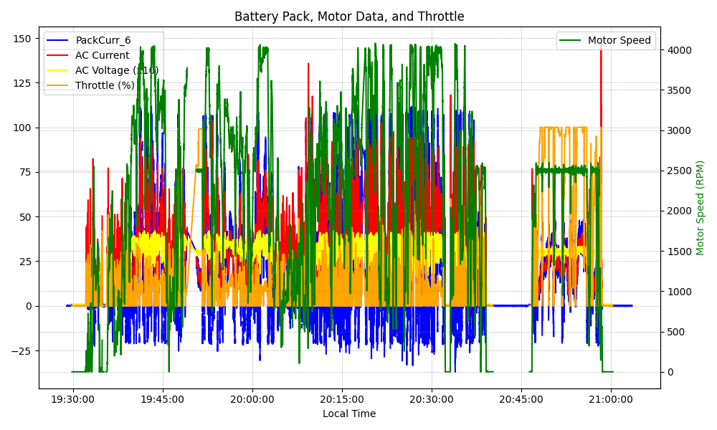
Graph Analysis

