Slide 1
Analysis Results from Folder - Battery_11

Slide 2
Analysis Results:
Metric | Value
Date and Time | 16/03/2024 21:08:00 to 16/03/2024 21:53:23
Byte Beam ID | 3
Total time taken for the ride | 0 days 00:45:23.822000
Actual Ampere-hours (Ah) | 24.465375833333333
Actual Watt-hours (Wh)- Calculated_UsingFormala | 1250.0162020605558
Starting SoC (Ah) | 10.019
Ending SoC (Ah) | 36.675
Starting SoC (%) | 100.0
Ending SoC (%) | 25.0
Total distance covered (km) | 32.82412434023585
Total energy consumption(WH/KM) | 38.0822406442168
Total SOC consumed(%) | 75.0
Mode | Custom mode 67.39% Sports mode 22.33% Eco mode 7.49%

Slide 3
Analysis Results:
Metric | Value
Peak Power(kW) | 6199.859715
Average Power(kW) | 1659.3135425582598
Total Energy Regenerated(kWh) | 118.00132053805554
Regenerative Effectiveness(%) | 8.625717038617072
Highest Cell Voltage(V) | 3.486
Lowest Cell Voltage(V) | 3.091
Difference in Cell Voltage(V) | 0.395
Minimum Temperature(C) | 33.0
Maximum Temperature(C) | 46.0
Difference in Temperature(C) | 13.0
Maximum Fet Temperature-BMS(C) | 73.0
Maximum Afe Temperature-BMS(C) | 66.0
Maximum PCB Temperature-BMS(C) | 64.0

Slide 4
Analysis Results:
Metric | Value
Maximum MCU Temperature(C) | 51.0
Maximum Motor Temperature(C) | 0.0
Abnormal Motor Temperature Detected(C) | True
highest cell temp(C) | 46.0
lowest cell temp(C) | 33.0
Difference between Highest and Lowest Cell Temperature at 100% SOC(C) | 13.0
Battery Voltage(V) | 56.0
Total energy charged(kWh)- Calculated_BatteryData | 1.3700610466666667
Electricity consumption units(kW) | 1.397622155574598e-07
Cycle Count of battery | 143.0
Idling time percentage | 3.4909723372536026
Time spent in 0-10 km/h | 4.203246645684943
Time spent in 10-20 km/h | 4.749875766108994

Slide 5
Analysis Results:
Metric | Value
Time spent in 20-30 km/h | 11.574457512009277
Time spent in 30-40 km/h | 13.309590856385622
Time spent in 40-50 km/h | 19.678648335265862
Time spent in 50-60 km/h | 27.8159681961239
Time spent in 60-70 km/h | 12.820937551764121
Time spent in 70-80 km/h | 2.198939870796753
Time spent in 80-90 km/h | 0.0

Slide 6
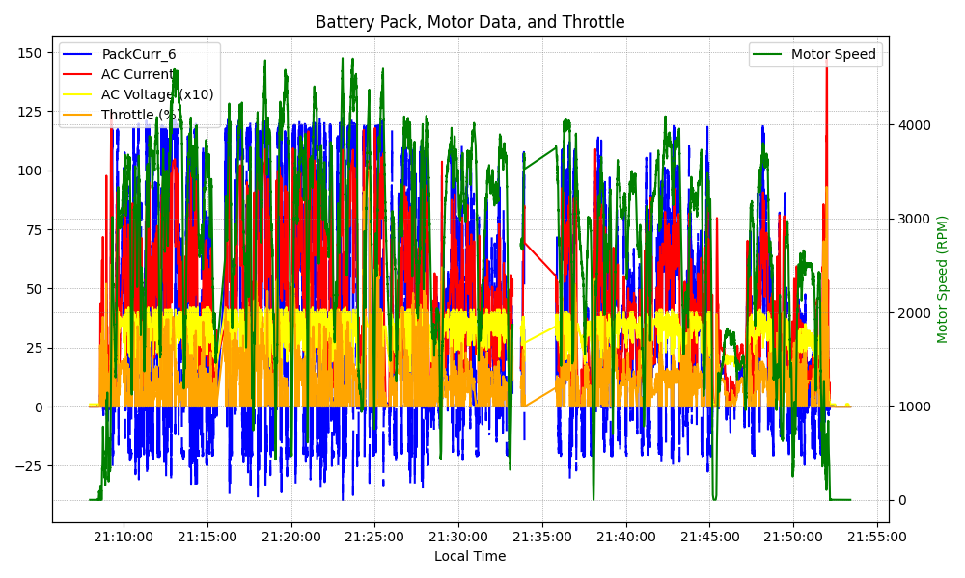
Graph Analysis

