Slide 1
Analysis Results from Folder - Battery_2

Slide 2
Analysis Results:
Metric | Value
Date and Time | 16/03/2024 07:17:03 to 16/03/2024 08:09:21
Byte Beam ID | 3
Total time taken for the ride | 0 days 00:52:17.878000
Actual Ampere-hours (Ah) | 27.160454166666664
Actual Watt-hours (Wh)- Calculated_UsingFormala | 1375.485278356111
Starting SoC (Ah) | 11.038
Ending SoC (Ah) | 39.407
Starting SoC (%) | 99.0
Ending SoC (%) | 27.0
Total distance covered (km) | 32.46805130762464
Total energy consumption(WH/KM) | 42.36426958069696
Total SOC consumed(%) | 72.0
Mode | Custom mode 91.83% Eco mode 0.38% Sports mode 0.19%

Slide 3
Analysis Results:
Metric | Value
Peak Power(kW) | 6189.91818
Average Power(kW) | 1587.098398103205
Total Energy Regenerated(kWh) | 60.45212410055556
Regenerative Effectiveness(%) | 4.209941463822262
Highest Cell Voltage(V) | 3.366
Lowest Cell Voltage(V) | 3.048
Difference in Cell Voltage(V) | 0.31800000000000006
Minimum Temperature(C) | 25.0
Maximum Temperature(C) | 41.0
Difference in Temperature(C) | 16.0
Maximum Fet Temperature-BMS(C) | 73.0
Maximum Afe Temperature-BMS(C) | 66.0
Maximum PCB Temperature-BMS(C) | 66.0

Slide 4
Analysis Results:
Metric | Value
Maximum MCU Temperature(C) | 47.0
Maximum Motor Temperature(C) | 0.0
Abnormal Motor Temperature Detected(C) | True
highest cell temp(C) | 41.0
lowest cell temp(C) | 25.0
Difference between Highest and Lowest Cell Temperature at 100% SOC(C) | 16.0
Battery Voltage(V) | 55.0
Total energy charged(kWh)- Calculated_BatteryData | 1.4938249791666665
Electricity consumption units(kW) | 1.3227650082940765e-07
Cycle Count of battery | 119.0
Idling time percentage | 25.042427533772315
Time spent in 0-10 km/h | 6.4116489036725275
Time spent in 10-20 km/h | 3.899938904351368

Slide 5
Analysis Results:
Metric | Value
Time spent in 20-30 km/h | 5.525761998506551
Time spent in 30-40 km/h | 7.487611160138484
Time spent in 40-50 km/h | 9.951802321634649
Time spent in 50-60 km/h | 13.953567307039577
Time spent in 60-70 km/h | 22.082682777815492
Time spent in 70-80 km/h | 5.1625823094155185
Time spent in 80-90 km/h | 0.4005159188106714

Slide 6
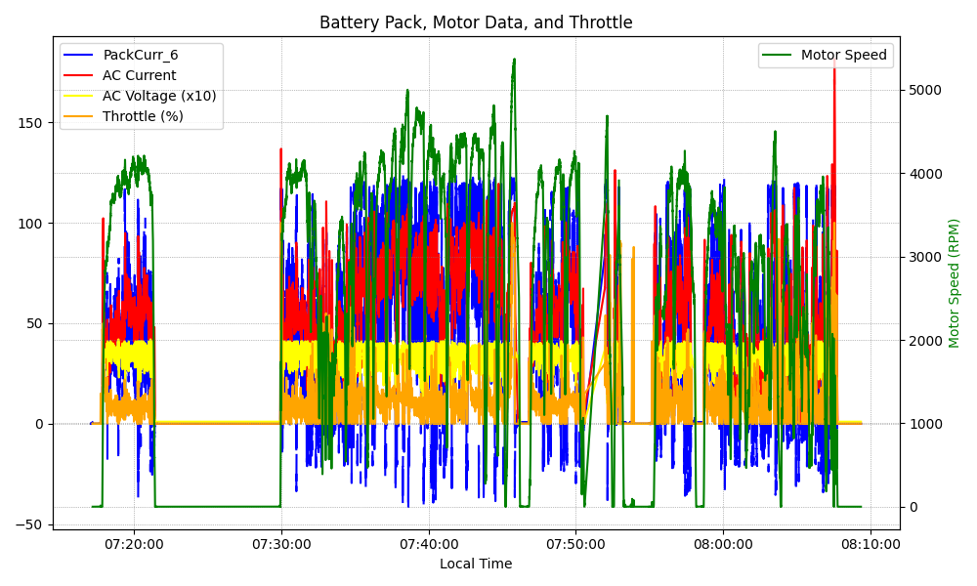
Graph Analysis

