Slide 1
Analysis Results from Folder - Battery_3

Slide 2
Analysis Results:
Metric | Value
Date and Time | 16/03/2024 08:23:00 to 16/03/2024 08:50:59
Byte Beam ID | 3
Total time taken for the ride | 0 days 00:27:59.926000
Actual Ampere-hours (Ah) | 18.69706722222222
Actual Watt-hours (Wh)- Calculated_UsingFormala | 938.626209488611
Starting SoC (Ah) | 10.181
Ending SoC (Ah) | 30.513
Starting SoC (%) | 77.0
Ending SoC (%) | 25.0
Total distance covered (km) | 22.30434076370542
Total energy consumption(WH/KM) | 42.082669890696074
Total SOC consumed(%) | 52.0
Mode | Custom mode 91.70% Eco mode 3.84% Sports mode 2.44%

Slide 3
Analysis Results:
Metric | Value
Peak Power(kW) | 6013.011549999999
Average Power(kW) | 2014.939984590936
Total Energy Regenerated(kWh) | 67.24093675638889
Regenerative Effectiveness(%) | 6.684872550754426
Highest Cell Voltage(V) | 3.345
Lowest Cell Voltage(V) | 3.005
Difference in Cell Voltage(V) | 0.3400000000000003
Minimum Temperature(C) | 27.0
Maximum Temperature(C) | 39.0
Difference in Temperature(C) | 12.0
Maximum Fet Temperature-BMS(C) | 69.0
Maximum Afe Temperature-BMS(C) | 61.0
Maximum PCB Temperature-BMS(C) | 59.0

Slide 4
Analysis Results:
Metric | Value
Maximum MCU Temperature(C) | 48.0
Maximum Motor Temperature(C) | 0.0
Abnormal Motor Temperature Detected(C) | True
highest cell temp(C) | 39.0
lowest cell temp(C) | 27.0
Difference between Highest and Lowest Cell Temperature at 100% SOC(C) | 12.0
Battery Voltage(V) | 65.0
Total energy charged(kWh)- Calculated_BatteryData | 1.2153093694444441
Electricity consumption units(kW) | 2.0106369026610484e-07
Cycle Count of battery | 140.0
Idling time percentage | 5.144018976618096
Time spent in 0-10 km/h | 3.632666892578787
Time spent in 10-20 km/h | 4.933920704845815

Slide 5
Analysis Results:
Metric | Value
Time spent in 20-30 km/h | 6.899356150457472
Time spent in 30-40 km/h | 9.915282954930532
Time spent in 40-50 km/h | 15.560826838359878
Time spent in 50-60 km/h | 24.967807522873603
Time spent in 60-70 km/h | 25.855642155201625
Time spent in 70-80 km/h | 2.893934259573026
Time spent in 80-90 km/h | 0.0

Slide 6
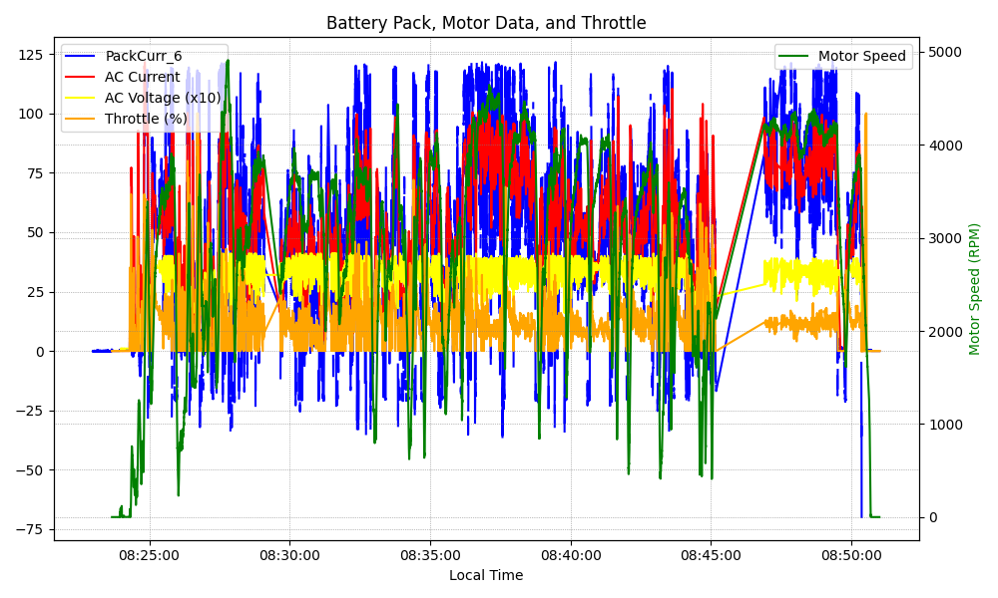
Graph Analysis

