Slide 1
Analysis Results from Folder - Battery_4

Slide 2
Analysis Results:
Metric | Value
Date and Time | 16/03/2024 08:52:33 to 16/03/2024 09:26:59
Byte Beam ID | 3
Total time taken for the ride | 0 days 00:34:26.007000
Actual Ampere-hours (Ah) | 20.153950833333333
Actual Watt-hours (Wh)- Calculated_UsingFormala | 1016.3960292424999
Starting SoC (Ah) | 10.639
Ending SoC (Ah) | 31.097
Starting SoC (%) | 78.0
Ending SoC (%) | 26.0
Total distance covered (km) | 22.559299708294215
Total energy consumption(WH/KM) | 45.054414028145075
Total SOC consumed(%) | 52.0
Mode | Custom mode 90.60% Sports mode 7.15% Eco mode 0.78%

Slide 3
Analysis Results:
Metric | Value
Peak Power(kW) | 5998.413312
Average Power(kW) | 1781.4146569001946
Total Energy Regenerated(kWh) | 45.205096757777774
Regenerative Effectiveness(%) | 4.258199774909239
Highest Cell Voltage(V) | 3.321
Lowest Cell Voltage(V) | 3.041
Difference in Cell Voltage(V) | 0.28000000000000025
Minimum Temperature(C) | 27.0
Maximum Temperature(C) | 38.0
Difference in Temperature(C) | 11.0
Maximum Fet Temperature-BMS(C) | 71.0
Maximum Afe Temperature-BMS(C) | 61.0
Maximum PCB Temperature-BMS(C) | 59.0

Slide 4
Analysis Results:
Metric | Value
Maximum MCU Temperature(C) | 53.0
Maximum Motor Temperature(C) | 0.0
Abnormal Motor Temperature Detected(C) | True
highest cell temp(C) | 38.0
lowest cell temp(C) | 27.0
Difference between Highest and Lowest Cell Temperature at 100% SOC(C) | 11.0
Battery Voltage(V) | 65.0
Total energy charged(kWh)- Calculated_BatteryData | 1.3100068041666666
Electricity consumption units(kW) | 1.7613300045265497e-07
Cycle Count of battery | 24.0
Idling time percentage | 22.85358322951086
Time spent in 0-10 km/h | 4.560966361518878
Time spent in 10-20 km/h | 4.7072206272682955

Slide 5
Analysis Results:
Metric | Value
Time spent in 20-30 km/h | 6.852283191593088
Time spent in 30-40 km/h | 7.832728454579925
Time spent in 40-50 km/h | 9.31152158604626
Time spent in 50-60 km/h | 15.892963544770055
Time spent in 60-70 km/h | 20.35642706245599
Time spent in 70-80 km/h | 7.486051676507231
Time spent in 80-90 km/h | 0.0

Slide 6
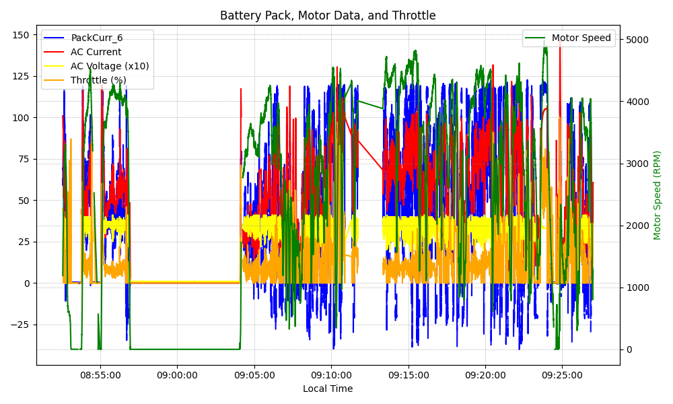
Graph Analysis

