Slide 1
Analysis Results from Folder - Battery_5

Slide 2
Analysis Results:
Metric | Value
Date and Time | 16/03/2024 09:58:39 to 16/03/2024 11:20:34
Byte Beam ID | 3
Total time taken for the ride | 0 days 01:21:54.190000
Actual Ampere-hours (Ah) | 29.455850555555557
Actual Watt-hours (Wh)- Calculated_UsingFormala | 1503.8460579047223
Starting SoC (Ah) | 10.533
Ending SoC (Ah) | 39.201
Starting SoC (%) | 98.0
Ending SoC (%) | 26.0
Total distance covered (km) | 38.590671604150835
Total energy consumption(WH/KM) | 38.96916004288891
Total SOC consumed(%) | 72.0
Mode | Custom mode 86.78% Eco mode 8.61% Sports mode 0.43%

Slide 3
Analysis Results:
Metric | Value
Peak Power(kW) | 6231.1183200000005
Average Power(kW) | 1107.5789297170622
Total Energy Regenerated(kWh) | 109.26179449916667
Regenerative Effectiveness(%) | 6.773371931476394
Highest Cell Voltage(V) | 3.472
Lowest Cell Voltage(V) | 3.057
Difference in Cell Voltage(V) | 0.41500000000000004
Minimum Temperature(C) | 33.0
Maximum Temperature(C) | 44.0
Difference in Temperature(C) | 11.0
Maximum Fet Temperature-BMS(C) | 71.0
Maximum Afe Temperature-BMS(C) | 66.0
Maximum PCB Temperature-BMS(C) | 64.0

Slide 4
Analysis Results:
Metric | Value
Maximum MCU Temperature(C) | 53.0
Maximum Motor Temperature(C) | 0.0
Abnormal Motor Temperature Detected(C) | True
highest cell temp(C) | 44.0
lowest cell temp(C) | 33.0
Difference between Highest and Lowest Cell Temperature at 100% SOC(C) | 11.0
Battery Voltage(V) | 56.0
Total energy charged(kWh)- Calculated_BatteryData | 1.6495276311111111
Electricity consumption units(kW) | 9.324422461397771e-08
Cycle Count of battery | 49.0
Idling time percentage | 32.440353428999416
Time spent in 0-10 km/h | 6.306580118533313
Time spent in 10-20 km/h | 6.026528884354037

Slide 5
Analysis Results:
Metric | Value
Time spent in 20-30 km/h | 7.394220958252827
Time spent in 30-40 km/h | 11.310596357163016
Time spent in 40-50 km/h | 15.43972385645746
Time spent in 50-60 km/h | 10.346699086034345
Time spent in 60-70 km/h | 7.370340620454595
Time spent in 70-80 km/h | 2.948136248181838
Time spent in 80-90 km/h | 0.30393157197750903

Slide 6
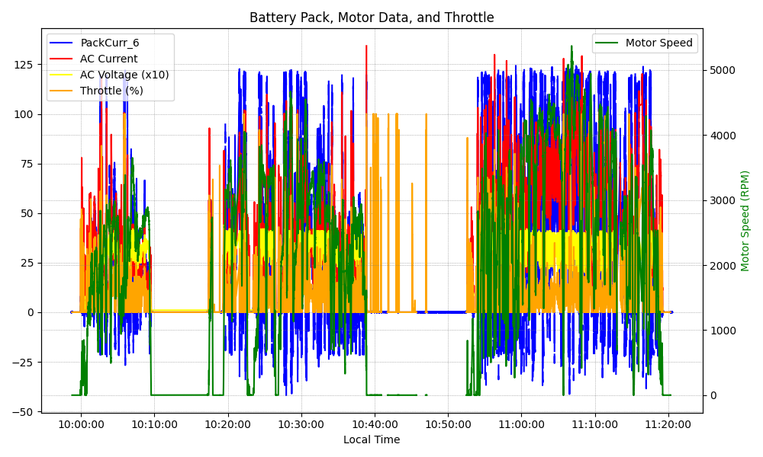
Graph Analysis

