Slide 1
Analysis Results from Folder - Battery_6

Slide 2
Analysis Results:
Metric | Value
Date and Time | 16/03/2024 11:34:03 to 16/03/2024 12:38:59
Byte Beam ID | 3
Total time taken for the ride | 0 days 01:04:56.349000
Actual Ampere-hours (Ah) | 15.997390277777779
Actual Watt-hours (Wh)- Calculated_UsingFormala | 821.664071705
Starting SoC (Ah) | 15.811
Ending SoC (Ah) | 37.049
Starting SoC (%) | 99.0
Ending SoC (%) | 39.0
Total distance covered (km) | 20.99208139635045
Total energy consumption(WH/KM) | 39.14161993711826
Total SOC consumed(%) | 60.0
Mode | Custom mode 77.29% Eco mode 10.88% Sports mode 2.10%

Slide 3
Analysis Results:
Metric | Value
Peak Power(kW) | 6406.913267999999
Average Power(kW) | 762.958642800619
Total Energy Regenerated(kWh) | 49.64198123222222
Regenerative Effectiveness(%) | 5.697421826105336
Highest Cell Voltage(V) | 3.538
Lowest Cell Voltage(V) | 3.115
Difference in Cell Voltage(V) | 0.4229999999999996
Minimum Temperature(C) | 38.0
Maximum Temperature(C) | 46.0
Difference in Temperature(C) | 8.0
Maximum Fet Temperature-BMS(C) | 71.0
Maximum Afe Temperature-BMS(C) | 69.0
Maximum PCB Temperature-BMS(C) | 68.0

Slide 4
Analysis Results:
Metric | Value
Maximum MCU Temperature(C) | 51.0
Maximum Motor Temperature(C) | 0.0
Abnormal Motor Temperature Detected(C) | False
highest cell temp(C) | 46.0
lowest cell temp(C) | 38.0
Difference between Highest and Lowest Cell Temperature at 100% SOC(C) | 8.0
Battery Voltage(V) | 55.0
Total energy charged(kWh)- Calculated_BatteryData | 0.8798564652777778
Electricity consumption units(kW) | 6.273218010479251e-08
Cycle Count of battery | 120.0
Idling time percentage | 46.3241555492478
Time spent in 0-10 km/h | 12.736304286119784
Time spent in 10-20 km/h | 4.7942094805563436

Slide 5
Analysis Results:
Metric | Value
Time spent in 20-30 km/h | 6.031791087141641
Time spent in 30-40 km/h | 5.9352824297473745
Time spent in 40-50 km/h | 8.887311950042577
Time spent in 50-60 km/h | 10.749361339767244
Time spent in 60-70 km/h | 3.5906897530513766
Time spent in 70-80 km/h | 0.8401930173147885
Time spent in 80-90 km/h | 0.03406187908032926

Slide 6
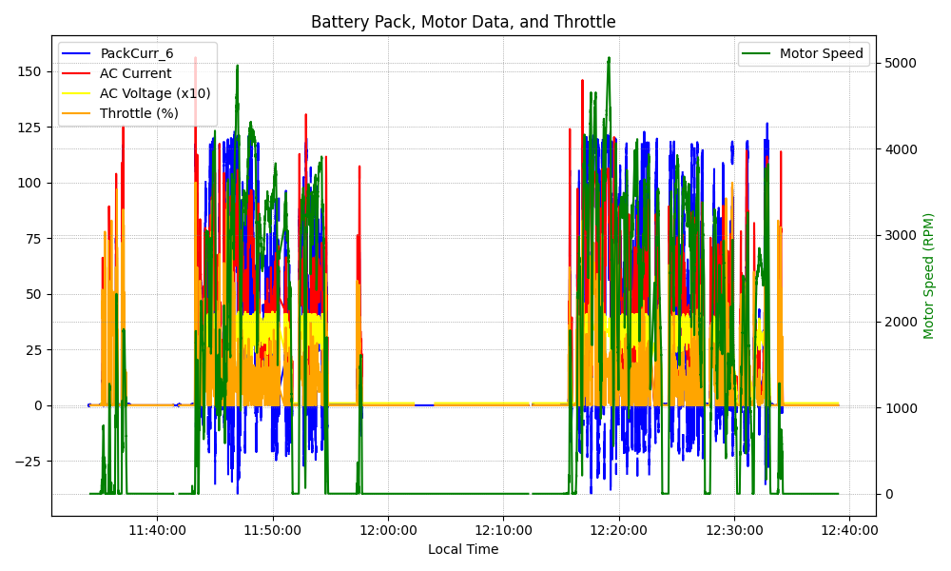
Graph Analysis

