Slide 1
Analysis Results from Folder - Battery_7

Slide 2
Analysis Results:
Metric | Value
Date and Time | 16/03/2024 13:16:00 to 16/03/2024 15:27:42
Byte Beam ID | 3
Total time taken for the ride | 0 days 02:11:42.277000
Actual Ampere-hours (Ah) | 36.65912472222222
Actual Watt-hours (Wh)- Calculated_UsingFormala | 1891.478136853611
Starting SoC (Ah) | 3.658
Ending SoC (Ah) | 39.573
Starting SoC (%) | 99.0
Ending SoC (%) | 9.0
Total distance covered (km) | 62.29238410408681
Total energy consumption(WH/KM) | 30.364516691046298
Total SOC consumed(%) | 90.0
Mode | Eco mode 93.71%

Slide 3
Analysis Results:
Metric | Value
Peak Power(kW) | 2550.02411
Average Power(kW) | 865.8852101567903
Total Energy Regenerated(kWh) | 91.209738175
Regenerative Effectiveness(%) | 4.600307457556011
Highest Cell Voltage(V) | 3.474
Lowest Cell Voltage(V) | 3.091
Difference in Cell Voltage(V) | 0.383
Minimum Temperature(C) | 36.0
Maximum Temperature(C) | 44.0
Difference in Temperature(C) | 8.0
Maximum Fet Temperature-BMS(C) | 53.0
Maximum Afe Temperature-BMS(C) | 57.0
Maximum PCB Temperature-BMS(C) | 54.0

Slide 4
Analysis Results:
Metric | Value
Maximum MCU Temperature(C) | 45.0
Maximum Motor Temperature(C) | 0.0
Abnormal Motor Temperature Detected(C) | False
highest cell temp(C) | 44.0
lowest cell temp(C) | 36.0
Difference between Highest and Lowest Cell Temperature at 100% SOC(C) | 8.0
Battery Voltage(V) | 55.0
Total energy charged(kWh)- Calculated_BatteryData | 2.016251859722222
Electricity consumption units(kW) | 7.08769882351241e-08
Cycle Count of battery | 47.0
Idling time percentage | 23.011523024470243
Time spent in 0-10 km/h | 2.6987757685612763
Time spent in 10-20 km/h | 2.516076129644815

Slide 5
Analysis Results:
Metric | Value
Time spent in 20-30 km/h | 7.3094241364924555
Time spent in 30-40 km/h | 41.820954353861865
Time spent in 40-50 km/h | 20.95147670219959
Time spent in 50-60 km/h | 0.0
Time spent in 60-70 km/h | 0.0
Time spent in 70-80 km/h | 0.0
Time spent in 80-90 km/h | 0.0

Slide 6
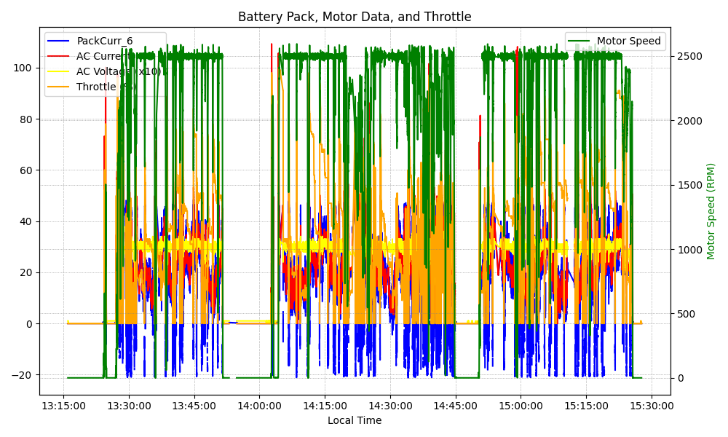
Graph Analysis

