Slide 1
Analysis Results from Folder - Battery_8

Slide 2
Analysis Results:
Metric | Value
Date and Time | 16/03/2024 15:29:02 to 16/03/2024 17:18:25
Byte Beam ID | 3
Total time taken for the ride | 0 days 01:49:22.906000
Actual Ampere-hours (Ah) | 32.03086694444445
Actual Watt-hours (Wh)- Calculated_UsingFormala | 1657.7859458519447
Starting SoC (Ah) | 5.704
Ending SoC (Ah) | 36.397
Starting SoC (%) | 91.0
Ending SoC (%) | 14.0
Total distance covered (km) | 51.851444910417186
Total energy consumption(WH/KM) | 31.97183701854542
Total SOC consumed(%) | 77.0
Mode | Eco mode 100.00%

Slide 3
Analysis Results:
Metric | Value
Peak Power(kW) | 2567.243028
Average Power(kW) | 916.6071886141915
Total Energy Regenerated(kWh) | 98.88805571750001
Regenerative Effectiveness(%) | 5.629277579627844
Highest Cell Voltage(V) | 3.43
Lowest Cell Voltage(V) | 3.125
Difference in Cell Voltage(V) | 0.30500000000000016
Minimum Temperature(C) | 37.0
Maximum Temperature(C) | 43.0
Difference in Temperature(C) | 6.0
Maximum Fet Temperature-BMS(C) | 51.0
Maximum Afe Temperature-BMS(C) | 54.0
Maximum PCB Temperature-BMS(C) | 51.0

Slide 4
Analysis Results:
Metric | Value
Maximum MCU Temperature(C) | 46.0
Maximum Motor Temperature(C) | 0.0
Abnormal Motor Temperature Detected(C) | False
highest cell temp(C) | 43.0
lowest cell temp(C) | 37.0
Difference between Highest and Lowest Cell Temperature at 100% SOC(C) | 6.0
Battery Voltage(V) | 55.0
Total energy charged(kWh)- Calculated_BatteryData | 1.7616976819444445
Electricity consumption units(kW) | 7.457489594739258e-08
Cycle Count of battery | 142.0
Idling time percentage | 14.40020170367569
Time spent in 0-10 km/h | 3.2974949123849657
Time spent in 10-20 km/h | 4.885911358438237

Slide 5
Analysis Results:
Metric | Value
Time spent in 20-30 km/h | 11.223368811569147
Time spent in 30-40 km/h | 42.8332162731644
Time spent in 40-50 km/h | 21.735371981198337
Time spent in 50-60 km/h | 0.0
Time spent in 60-70 km/h | 0.0
Time spent in 70-80 km/h | 0.0
Time spent in 80-90 km/h | 0.0

Slide 6
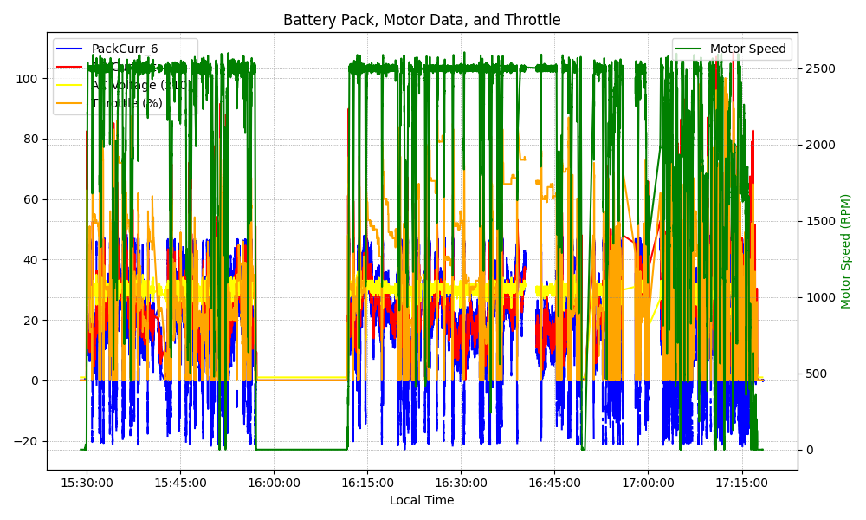
Graph Analysis

