Slide 1
Analysis Results from Folder - Battery_1

Slide 2
Analysis Results:
Metric | Value
Date and Time | 17/03/2024 07:51:27 to 17/03/2024 10:01:09
Byte Beam ID | 3
Total time taken for the ride | 0 days 02:09:42.125000
Actual Ampere-hours (Ah) | 34.05309361111111
Actual Watt-hours (Wh)- Calculated_UsingFormala | 1757.4205689005557
Starting SoC (Ah) | 4.898
Ending SoC (Ah) | 39.439
Starting SoC (%) | 99.0
Ending SoC (%) | 12.0
Total distance covered (km) | 75.28762263712073
Total energy consumption(WH/KM) | 23.34275552000304
Total SOC consumed(%) | 87.0
Mode | Eco mode 97.97%

Slide 3
Analysis Results:
Metric | Value
Peak Power(kW) | 2495.5198189999996
Average Power(kW) | 818.5682556659335
Total Energy Regenerated(kWh) | 22.335885170555557
Regenerative Effectiveness(%) | 1.2549967226955827
Highest Cell Voltage(V) | 3.383
Lowest Cell Voltage(V) | 3.07
Difference in Cell Voltage(V) | 0.31300000000000017
Minimum Temperature(C) | 27.0
Maximum Temperature(C) | 35.0
Difference in Temperature(C) | 8.0
Maximum Fet Temperature-BMS(C) | 45.0
Maximum Afe Temperature-BMS(C) | 47.0
Maximum PCB Temperature-BMS(C) | 46.0

Slide 4
Analysis Results:
Metric | Value
Maximum MCU Temperature(C) | 33.0
Maximum Motor Temperature(C) | 0.0
Abnormal Motor Temperature Detected(C) | False
highest cell temp(C) | 35.0
lowest cell temp(C) | 27.0
Difference between Highest and Lowest Cell Temperature at 100% SOC(C) | 8.0
Battery Voltage(V) | 56.0
Total energy charged(kWh)- Calculated_BatteryData | 1.906973242222222
Electricity consumption units(kW) | 6.806923535160277e-08
Cycle Count of battery | 121.0
Idling time percentage | 11.700914829129939
Time spent in 0-10 km/h | 2.1675054917554153
Time spent in 10-20 km/h | 1.2554569974696217

Slide 5
Analysis Results:
Metric | Value
Time spent in 20-30 km/h | 1.8282679420515529
Time spent in 30-40 km/h | 46.732753107360345
Time spent in 40-50 km/h | 33.53585629674944
Time spent in 50-60 km/h | 0.0
Time spent in 60-70 km/h | 0.0
Time spent in 70-80 km/h | 0.0
Time spent in 80-90 km/h | 0.0

Slide 6
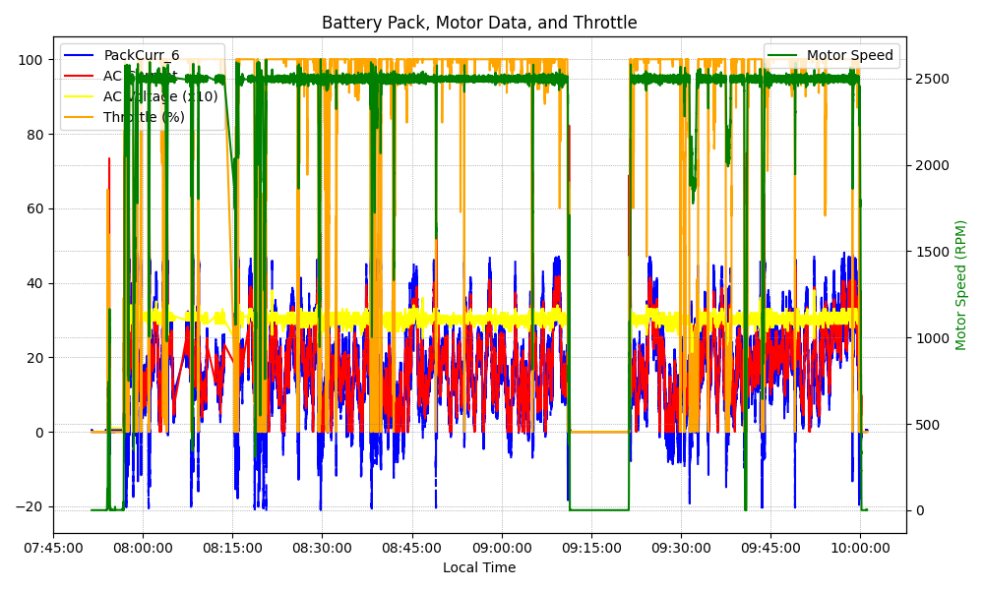
Graph Analysis

