Slide 1
Analysis Results from Folder - Battery_2

Slide 2
Analysis Results:
Metric | Value
Date and Time | 17/03/2024 10:08:53 to 17/03/2024 11:37:40
Byte Beam ID | 3
Total time taken for the ride | 0 days 01:28:46.836000
Actual Ampere-hours (Ah) | 27.778490833333333
Actual Watt-hours (Wh)- Calculated_UsingFormala | 1440.3575297183334
Starting SoC (Ah) | 11.204
Ending SoC (Ah) | 39.344
Starting SoC (%) | 99.0
Ending SoC (%) | 28.0
Total distance covered (km) | 55.64894226783255
Total energy consumption(WH/KM) | 25.882927348125374
Total SOC consumed(%) | 71.0
Mode | Eco mode 98.97%

Slide 3
Analysis Results:
Metric | Value
Peak Power(kW) | 2483.062401
Average Power(kW) | 978.3560579218869
Total Energy Regenerated(kWh) | 27.064832464722222
Regenerative Effectiveness(%) | 1.844379175499166
Highest Cell Voltage(V) | 3.393
Lowest Cell Voltage(V) | 3.156
Difference in Cell Voltage(V) | 0.23699999999999966
Minimum Temperature(C) | 28.0
Maximum Temperature(C) | 35.0
Difference in Temperature(C) | 7.0
Maximum Fet Temperature-BMS(C) | 41.0
Maximum Afe Temperature-BMS(C) | 44.0
Maximum PCB Temperature-BMS(C) | 42.0

Slide 4
Analysis Results:
Metric | Value
Maximum MCU Temperature(C) | 39.0
Maximum Motor Temperature(C) | 0.0
Abnormal Motor Temperature Detected(C) | False
highest cell temp(C) | 35.0
lowest cell temp(C) | 28.0
Difference between Highest and Lowest Cell Temperature at 100% SOC(C) | 7.0
Battery Voltage(V) | 55.0
Total energy charged(kWh)- Calculated_BatteryData | 1.5278169958333332
Electricity consumption units(kW) | 7.96833664952504e-08
Cycle Count of battery | 51.0
Idling time percentage | 4.378044683352932
Time spent in 0-10 km/h | 2.0136905761800774
Time spent in 10-20 km/h | 1.7974130690408197

Slide 5
Analysis Results:
Metric | Value
Time spent in 20-30 km/h | 2.381152360154544
Time spent in 30-40 km/h | 50.21837728876197
Time spent in 40-50 km/h | 36.09524609440618
Time spent in 50-60 km/h | 0.0
Time spent in 60-70 km/h | 0.0
Time spent in 70-80 km/h | 0.0
Time spent in 80-90 km/h | 0.0

Slide 6
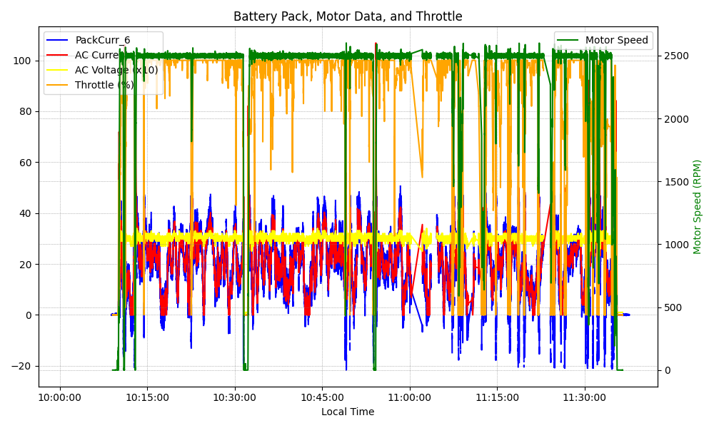
Graph Analysis

