Slide 1
Analysis Results from Folder - Battery_6

Slide 2
Analysis Results:
Metric | Value
Date and Time | 17/03/2024 12:58:51 to 17/03/2024 13:34:29
Byte Beam ID | 3
Total time taken for the ride | 0 days 00:35:38.047000
Actual Ampere-hours (Ah) | 19.64129972222222
Actual Watt-hours (Wh)- Calculated_UsingFormala | 1008.4635403447222
Starting SoC (Ah) | 16.132
Ending SoC (Ah) | 36.217
Starting SoC (%) | 91.0
Ending SoC (%) | 40.0
Total distance covered (km) | 28.388332723918236
Total energy consumption(WH/KM) | 35.52387349240323
Total SOC consumed(%) | 51.0
Mode | Custom mode 100.00%

Slide 3
Analysis Results:
Metric | Value
Peak Power(kW) | 6056.326136
Average Power(kW) | 1711.67786197124
Total Energy Regenerated(kWh) | 39.05386690444444
Regenerative Effectiveness(%) | 3.7282308278773
Highest Cell Voltage(V) | 3.325
Lowest Cell Voltage(V) | 3.063
Difference in Cell Voltage(V) | 0.262
Minimum Temperature(C) | 31.0
Maximum Temperature(C) | 39.0
Difference in Temperature(C) | 8.0
Maximum Fet Temperature-BMS(C) | 68.0
Maximum Afe Temperature-BMS(C) | 59.0
Maximum PCB Temperature-BMS(C) | 56.0

Slide 4
Analysis Results:
Metric | Value
Maximum MCU Temperature(C) | 51.0
Maximum Motor Temperature(C) | 0.0
Abnormal Motor Temperature Detected(C) | False
highest cell temp(C) | 39.0
lowest cell temp(C) | 31.0
Difference between Highest and Lowest Cell Temperature at 100% SOC(C) | 8.0
Battery Voltage(V) | 55.0
Total energy charged(kWh)- Calculated_BatteryData | 1.0802714847222221
Electricity consumption units(kW) | 1.4035332667111294e-07
Cycle Count of battery | 143.0
Idling time percentage | 0.1583920476268502
Time spent in 0-10 km/h | 3.3371565896553608
Time spent in 10-20 km/h | 3.2661532579605654

Slide 5
Analysis Results:
Metric | Value
Time spent in 20-30 km/h | 5.276093724397837
Time spent in 30-40 km/h | 8.067070839477852
Time spent in 40-50 km/h | 21.03337156589655
Time spent in 50-60 km/h | 51.70681085804796
Time spent in 60-70 km/h | 4.735376044568245
Time spent in 70-80 km/h | 1.6986181659293245
Time spent in 80-90 km/h | 0.5898738325413732

Slide 6
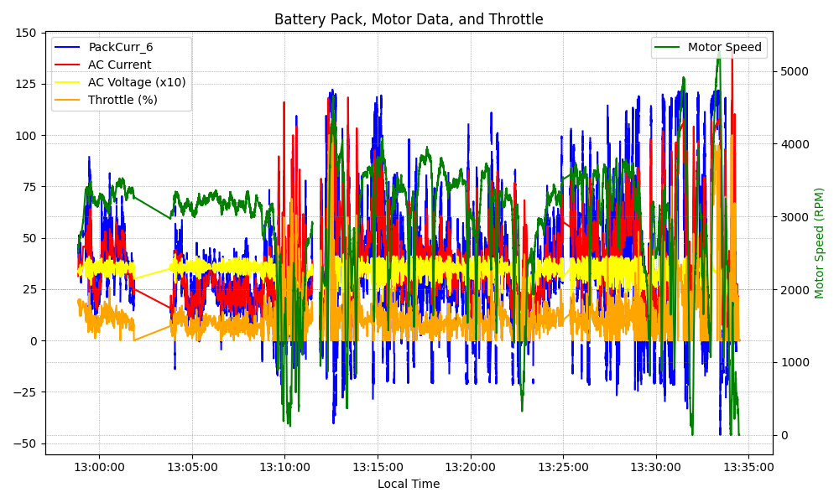
Graph Analysis

