Slide 1
Analysis Results from Folder - Battery_1

Slide 2
Analysis Results:
Metric | Value
Date and Time | 18/03/2024 07:03:31 to 18/03/2024 08:00:43
Byte Beam ID | 3
Total time taken for the ride | 0 days 00:57:12.330000
Actual Ampere-hours (Ah) | 29.039475
Actual Watt-hours (Wh)- Calculated_UsingFormala | 1490.3266972474999
Starting SoC (Ah) | 10.141
Ending SoC (Ah) | 39.245
Starting SoC (%) | 99.0
Ending SoC (%) | 25.0
Total distance covered (km) | 44.76151597941912
Total energy consumption(WH/KM) | 33.294821782460104
Total SOC consumed(%) | 74.0
Mode | Custom mode 96.32% Eco mode 0.63%

Slide 3
Analysis Results:
Metric | Value
Peak Power(kW) | 5995.685239
Average Power(kW) | 1574.2887646980632
Total Energy Regenerated(kWh) | 24.015788658333335
Regenerative Effectiveness(%) | 1.5858888515544636
Highest Cell Voltage(V) | 3.365
Lowest Cell Voltage(V) | 3.056
Difference in Cell Voltage(V) | 0.30900000000000016
Minimum Temperature(C) | 26.0
Maximum Temperature(C) | 35.0
Difference in Temperature(C) | 9.0
Maximum Fet Temperature-BMS(C) | 46.0
Maximum Afe Temperature-BMS(C) | 46.0
Maximum PCB Temperature-BMS(C) | 44.0

Slide 4
Analysis Results:
Metric | Value
Maximum MCU Temperature(C) | 33.0
Maximum Motor Temperature(C) | 0.0
Abnormal Motor Temperature Detected(C) | False
highest cell temp(C) | 35.0
lowest cell temp(C) | 26.0
Difference between Highest and Lowest Cell Temperature at 100% SOC(C) | 9.0
Battery Voltage(V) | 55.0
Total energy charged(kWh)- Calculated_BatteryData | 1.597171125
Electricity consumption units(kW) | 1.292711672008547e-07
Cycle Count of battery | 52.0
Idling time percentage | 2.476315542632023
Time spent in 0-10 km/h | 4.508645217771941
Time spent in 10-20 km/h | 1.2725510427414564

Slide 5
Analysis Results:
Metric | Value
Time spent in 20-30 km/h | 3.079761123096645
Time spent in 30-40 km/h | 3.1704342932182725
Time spent in 40-50 km/h | 5.678016446237064
Time spent in 50-60 km/h | 75.45571084638715
Time spent in 60-70 km/h | 4.280398961948535
Time spent in 70-80 km/h | 0.0
Time spent in 80-90 km/h | 0.0

Slide 6
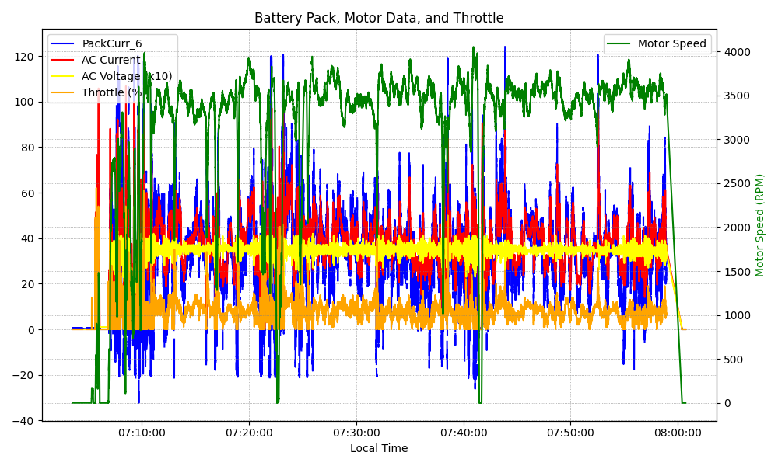
Graph Analysis

