Slide 1
Analysis Results from Folder - Battery_10

Slide 2
Analysis Results:
Metric | Value
Date and Time | 18/03/2024 16:16:13 to 18/03/2024 17:18:10
Byte Beam ID | 3
Total time taken for the ride | 0 days 01:01:56.732000
Actual Ampere-hours (Ah) | 32.55491
Actual Watt-hours (Wh)- Calculated_UsingFormala | 1666.983824860278
Starting SoC (Ah) | 9.415
Ending SoC (Ah) | 39.6
Starting SoC (%) | 99.0
Ending SoC (%) | 23.0
Total distance covered (km) | 35.345420122222535
Total energy consumption(WH/KM) | 47.16265414574049
Total SOC consumed(%) | 76.0
Mode | Sports mode 77.34% Eco mode 9.70% Custom mode 0.16%

Slide 3
Analysis Results:
Metric | Value
Peak Power(kW) | 5676.452487
Average Power(kW) | 1622.3686859954043
Total Energy Regenerated(kWh) | 101.40218871416667
Regenerative Effectiveness(%) | 5.7341659533487315
Highest Cell Voltage(V) | 3.539
Lowest Cell Voltage(V) | 3.073
Difference in Cell Voltage(V) | 0.4660000000000002
Minimum Temperature(C) | 39.0
Maximum Temperature(C) | 50.0
Difference in Temperature(C) | 11.0
Maximum Fet Temperature-BMS(C) | 72.0
Maximum Afe Temperature-BMS(C) | 70.0
Maximum PCB Temperature-BMS(C) | 67.0

Slide 4
Analysis Results:
Metric | Value
Maximum MCU Temperature(C) | 56.0
Maximum Motor Temperature(C) | 0.0
Abnormal Motor Temperature Detected(C) | False
highest cell temp(C) | 50.0
lowest cell temp(C) | 39.0
Difference between Highest and Lowest Cell Temperature at 100% SOC(C) | 11.0
Battery Voltage(V) | 56.0
Total energy charged(kWh)- Calculated_BatteryData | 1.82307496
Electricity consumption units(kW) | 1.362781784475541e-07
Cycle Count of battery | 50.0
Idling time percentage | 7.105682096497673
Time spent in 0-10 km/h | 16.49216262552045
Time spent in 10-20 km/h | 3.676830761694832

Slide 5
Analysis Results:
Metric | Value
Time spent in 20-30 km/h | 8.77112417340191
Time spent in 30-40 km/h | 13.09392603477835
Time spent in 40-50 km/h | 18.601518491305413
Time spent in 50-60 km/h | 24.571393583149646
Time spent in 60-70 km/h | 7.4944893460690665
Time spent in 70-80 km/h | 0.0
Time spent in 80-90 km/h | 0.0

Slide 6
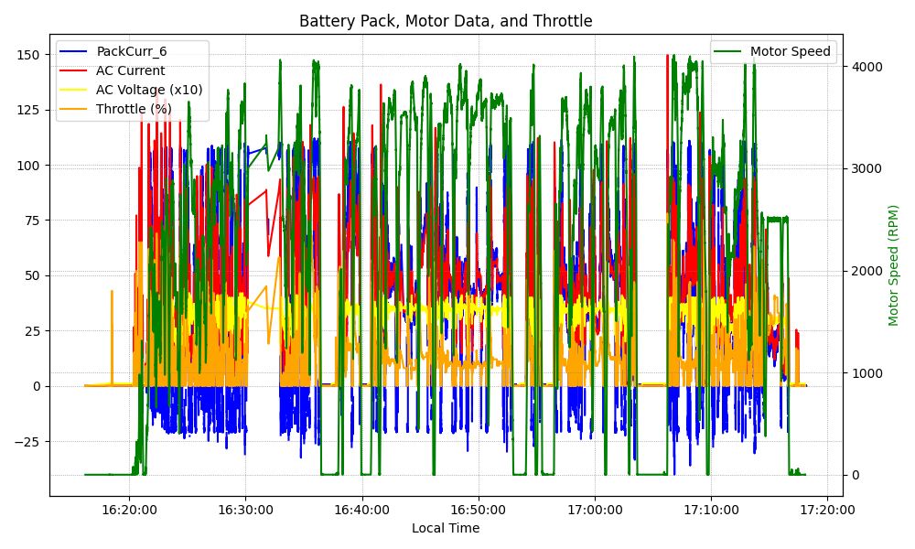
Graph Analysis

