Slide 1
Analysis Results from Folder - Battery_12

Slide 2
Analysis Results:
Metric | Value
Date and Time | 18/03/2024 17:20:31 to 18/03/2024 17:55:02
Byte Beam ID | 3
Total time taken for the ride | 0 days 00:34:31.086000
Actual Ampere-hours (Ah) | 6.87697
Actual Watt-hours (Wh)- Calculated_UsingFormala | 344.80052252
Starting SoC (Ah) | 2.384
Ending SoC (Ah) | 9.415
Starting SoC (%) | 23.0
Ending SoC (%) | 0.0
Total distance covered (km) | 11.679992654404678
Total energy consumption(WH/KM) | 29.52061124712876
Total SOC consumed(%) | 23.0
Mode | Eco mode 94.56%

Slide 3
Analysis Results:
Metric | Value
Peak Power(kW) | 2364.102
Average Power(kW) | 603.1496020758018
Total Energy Regenerated(kWh) | 9.01917538888889
Regenerative Effectiveness(%) | 2.5490879796102797
Highest Cell Voltage(V) | 3.242
Lowest Cell Voltage(V) | 2.983
Difference in Cell Voltage(V) | 0.2589999999999999
Minimum Temperature(C) | 46.0
Maximum Temperature(C) | 51.0
Difference in Temperature(C) | 5.0
Maximum Fet Temperature-BMS(C) | 61.0
Maximum Afe Temperature-BMS(C) | 66.0
Maximum PCB Temperature-BMS(C) | 63.0

Slide 4
Analysis Results:
Metric | Value
Maximum MCU Temperature(C) | 46.0
Maximum Motor Temperature(C) | 0.0
Abnormal Motor Temperature Detected(C) | False
highest cell temp(C) | 51.0
lowest cell temp(C) | 46.0
Difference between Highest and Lowest Cell Temperature at 100% SOC(C) | 5.0
Battery Voltage(V) | 53.0
Total energy charged(kWh)- Calculated_BatteryData | 0.36447941
Electricity consumption units(kW) | 4.888666371586458e-08
Cycle Count of battery | 50.0
Idling time percentage | 41.48143937240634
Time spent in 0-10 km/h | 5.1048831788983
Time spent in 10-20 km/h | 9.31157978511739

Slide 5
Analysis Results:
Metric | Value
Time spent in 20-30 km/h | 11.227332158490137
Time spent in 30-40 km/h | 28.309931214825763
Time spent in 40-50 km/h | 4.19532715593201
Time spent in 50-60 km/h | 0.0
Time spent in 60-70 km/h | 0.0
Time spent in 70-80 km/h | 0.0
Time spent in 80-90 km/h | 0.0

Slide 6
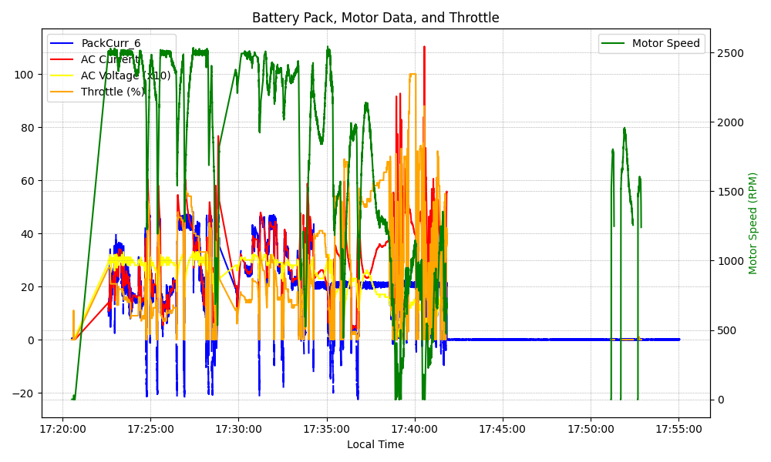
Graph Analysis

