Slide 1
Analysis Results from Folder - Battery_13

Slide 2
Analysis Results:
Metric | Value
Date and Time | 18/03/2024 17:56:35 to 18/03/2024 20:12:10
Byte Beam ID | 3
Total time taken for the ride | 0 days 02:15:34.949000
Actual Ampere-hours (Ah) | 30.276746666666668
Actual Watt-hours (Wh)- Calculated_UsingFormala | 1571.6773589747222
Starting SoC (Ah) | 6.229
Ending SoC (Ah) | 39.518
Starting SoC (%) | 100.0
Ending SoC (%) | 15.0
Total distance covered (km) | 59.95864458737061
Total energy consumption(WH/KM) | 26.212689926379234
Total SOC consumed(%) | 85.0
Mode | Sports mode 56.69% Eco mode 38.55%

Slide 3
Analysis Results:
Metric | Value
Peak Power(kW) | 5432.481768
Average Power(kW) | 697.7479951053151
Total Energy Regenerated(kWh) | 77.80908306416667
Regenerative Effectiveness(%) | 4.717170210140607
Highest Cell Voltage(V) | 3.482
Lowest Cell Voltage(V) | 3.111
Difference in Cell Voltage(V) | 0.371
Minimum Temperature(C) | 34.0
Maximum Temperature(C) | 40.0
Difference in Temperature(C) | 6.0
Maximum Fet Temperature-BMS(C) | 48.0
Maximum Afe Temperature-BMS(C) | 49.0
Maximum PCB Temperature-BMS(C) | 46.0

Slide 4
Analysis Results:
Metric | Value
Maximum MCU Temperature(C) | 41.0
Maximum Motor Temperature(C) | 0.0
Abnormal Motor Temperature Detected(C) | False
highest cell temp(C) | 40.0
lowest cell temp(C) | 34.0
Difference between Highest and Lowest Cell Temperature at 100% SOC(C) | 6.0
Battery Voltage(V) | 56.0
Total energy charged(kWh)- Calculated_BatteryData | 1.6954978133333334
Electricity consumption units(kW) | 5.790160005099764e-08
Cycle Count of battery | 145.0
Idling time percentage | 12.061975504649581
Time spent in 0-10 km/h | 8.274268541619415
Time spent in 10-20 km/h | 8.264345656611477

Slide 5
Analysis Results:
Metric | Value
Time spent in 20-30 km/h | 16.439385348151507
Time spent in 30-40 km/h | 43.533114084826494
Time spent in 40-50 km/h | 10.893910183715128
Time spent in 50-60 km/h | 0.09497618507598095
Time spent in 60-70 km/h | 0.1445906101156725
Time spent in 70-80 km/h | 0.0
Time spent in 80-90 km/h | 0.0

Slide 6
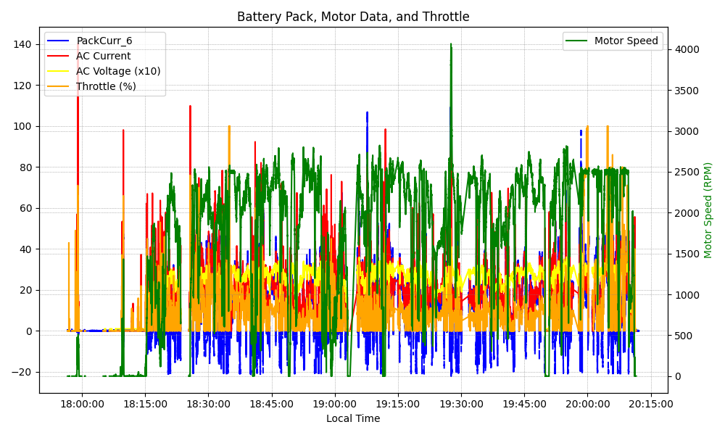
Graph Analysis

