Slide 1
Analysis Results from Folder - Battery_15

Slide 2
Analysis Results:
Metric | Value
Date and Time | 18/03/2024 20:15:30 to 18/03/2024 21:30:20
Byte Beam ID | 3
Total time taken for the ride | 0 days 01:14:49.600000
Actual Ampere-hours (Ah) | 21.17737527777778
Actual Watt-hours (Wh)- Calculated_UsingFormala | 1103.7575327822221
Starting SoC (Ah) | 17.705
Ending SoC (Ah) | 39.112
Starting SoC (%) | 98.0
Ending SoC (%) | 44.0
Total distance covered (km) | 41.51221738287841
Total energy consumption(WH/KM) | 26.588739469201748
Total SOC consumed(%) | 54.0
Mode | Sports mode 90.31% Eco mode 9.69%

Slide 3
Analysis Results:
Metric | Value
Peak Power(kW) | 4968.107992
Average Power(kW) | 887.9390207856983
Total Energy Regenerated(kWh) | 45.164430600833334
Regenerative Effectiveness(%) | 3.931026826908637
Highest Cell Voltage(V) | 3.339
Lowest Cell Voltage(V) | 3.138
Difference in Cell Voltage(V) | 0.20100000000000007
Minimum Temperature(C) | 32.0
Maximum Temperature(C) | 36.0
Difference in Temperature(C) | 4.0
Maximum Fet Temperature-BMS(C) | 45.0
Maximum Afe Temperature-BMS(C) | 48.0
Maximum PCB Temperature-BMS(C) | 47.0

Slide 4
Analysis Results:
Metric | Value
Maximum MCU Temperature(C) | 36.0
Maximum Motor Temperature(C) | 0.0
Abnormal Motor Temperature Detected(C) | False
highest cell temp(C) | 36.0
lowest cell temp(C) | 32.0
Difference between Highest and Lowest Cell Temperature at 100% SOC(C) | 4.0
Battery Voltage(V) | 55.0
Total energy charged(kWh)- Calculated_BatteryData | 1.164755640277778
Electricity consumption units(kW) | 7.207467886177186e-08
Cycle Count of battery | 124.0
Idling time percentage | 0.009650413761490024
Time spent in 0-10 km/h | 1.7057106323433615
Time spent in 10-20 km/h | 5.042341190378537

Slide 5
Analysis Results:
Metric | Value
Time spent in 20-30 km/h | 24.27320321358778
Time spent in 30-40 km/h | 49.557287268691645
Time spent in 40-50 km/h | 19.09816883398876
Time spent in 50-60 km/h | 0.0
Time spent in 60-70 km/h | 0.0
Time spent in 70-80 km/h | 0.0
Time spent in 80-90 km/h | 0.0

Slide 6
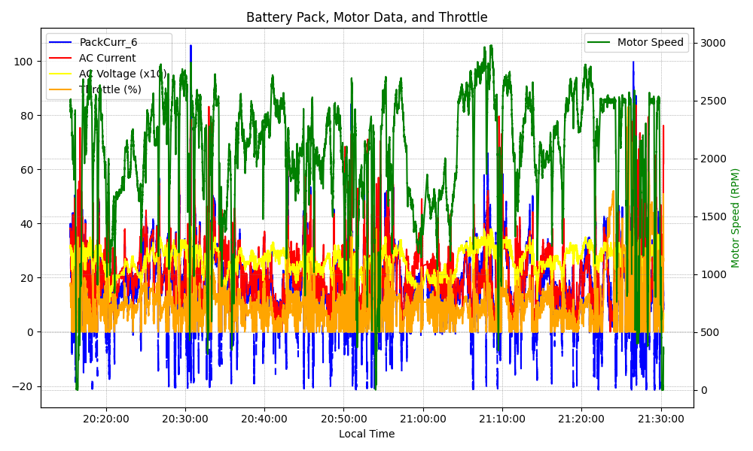
Graph Analysis

