Slide 1
Analysis Results from Folder - Battery_4

Slide 2
Analysis Results:
Metric | Value
Date and Time | 18/03/2024 08:42:55 to 18/03/2024 09:20:56
Byte Beam ID | 3
Total time taken for the ride | 0 days 00:38:01.177000
Actual Ampere-hours (Ah) | 17.096136666666666
Actual Watt-hours (Wh)- Calculated_UsingFormala | 868.3711966622222
Starting SoC (Ah) | 39.265
Ending SoC (Ah) | 25.087
Starting SoC (%) | 99.0
Ending SoC (%) | 19.0
Total distance covered (km) | 26.203280888109543
Total energy consumption(WH/KM) | 33.13978888255438
Total SOC consumed(%) | 80.0
Mode | Custom mode 75.57% Eco mode 24.15%

Slide 3
Analysis Results:
Metric | Value
Peak Power(kW) | 5825.985
Average Power(kW) | 1378.3669788289242
Total Energy Regenerated(kWh) | 26.576674461666666
Regenerative Effectiveness(%) | 2.969633798702854
Highest Cell Voltage(V) | 3.369
Lowest Cell Voltage(V) | 3.035
Difference in Cell Voltage(V) | 0.3340000000000001
Minimum Temperature(C) | 27.0
Maximum Temperature(C) | 38.0
Difference in Temperature(C) | 11.0
Maximum Fet Temperature-BMS(C) | 55.0
Maximum Afe Temperature-BMS(C) | 54.0
Maximum PCB Temperature-BMS(C) | 53.0

Slide 4
Analysis Results:
Metric | Value
Maximum MCU Temperature(C) | 39.0
Maximum Motor Temperature(C) | 0.0
Abnormal Motor Temperature Detected(C) | False
highest cell temp(C) | 40.0
lowest cell temp(C) | 27.0
Difference between Highest and Lowest Cell Temperature at 100% SOC(C) | 13.0
Battery Voltage(V) | 54.0
Total energy charged(kWh)- Calculated_BatteryData | 0.92319138
Electricity consumption units(kW) | 1.1242527400263042e-07
Cycle Count of battery | 122.0
Idling time percentage | 7.077137315362809
Time spent in 0-10 km/h | 2.486696175461282
Time spent in 10-20 km/h | 3.6504699855771623

Slide 5
Analysis Results:
Metric | Value
Time spent in 20-30 km/h | 4.22738349828418
Time spent in 30-40 km/h | 11.96598199631969
Time spent in 40-50 km/h | 20.679365395136024
Time spent in 50-60 km/h | 48.49554881384592
Time spent in 60-70 km/h | 0.9200775849206745
Time spent in 70-80 km/h | 0.06465410056199333
Time spent in 80-90 km/h | 0.0

Slide 6
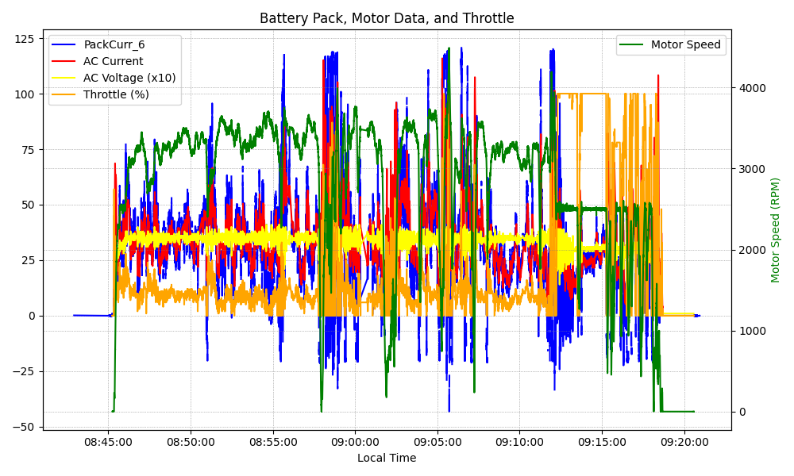
Graph Analysis

