Slide 1
Analysis Results from Folder - Battery_5

Slide 2
Analysis Results:
Metric | Value
Date and Time | 18/03/2024 09:21:50 to 18/03/2024 10:33:26
Byte Beam ID | 3
Total time taken for the ride | 0 days 01:11:36.216000
Actual Ampere-hours (Ah) | 26.472391666666667
Actual Watt-hours (Wh)- Calculated_UsingFormala | 1358.4853675250001
Starting SoC (Ah) | 9.959
Ending SoC (Ah) | 36.323
Starting SoC (%) | 91.0
Ending SoC (%) | 25.0
Total distance covered (km) | 38.64036622924434
Total energy consumption(WH/KM) | 35.15715558867691
Total SOC consumed(%) | 66.0
Mode | Custom mode 80.23% Eco mode 16.97%

Slide 3
Analysis Results:
Metric | Value
Peak Power(kW) | 6016.919622
Average Power(kW) | 1145.0590782228987
Total Energy Regenerated(kWh) | 40.16938755694444
Regenerative Effectiveness(%) | 2.872001643793147
Highest Cell Voltage(V) | 3.391
Lowest Cell Voltage(V) | 3.075
Difference in Cell Voltage(V) | 0.31599999999999984
Minimum Temperature(C) | 27.0
Maximum Temperature(C) | 36.0
Difference in Temperature(C) | 9.0
Maximum Fet Temperature-BMS(C) | 51.0
Maximum Afe Temperature-BMS(C) | 52.0
Maximum PCB Temperature-BMS(C) | 49.0

Slide 4
Analysis Results:
Metric | Value
Maximum MCU Temperature(C) | 40.0
Maximum Motor Temperature(C) | 0.0
Abnormal Motor Temperature Detected(C) | False
highest cell temp(C) | 36.0
lowest cell temp(C) | 27.0
Difference between Highest and Lowest Cell Temperature at 100% SOC(C) | 9.0
Battery Voltage(V) | 55.0
Total energy charged(kWh)- Calculated_BatteryData | 1.4559815416666668
Electricity consumption units(kW) | 9.414323024432721e-08
Cycle Count of battery | 144.0
Idling time percentage | 34.79345645352127
Time spent in 0-10 km/h | 1.610165131951232
Time spent in 10-20 km/h | 2.5824373681773753

Slide 5
Analysis Results:
Metric | Value
Time spent in 20-30 km/h | 5.018262256288904
Time spent in 30-40 km/h | 5.640722259375482
Time spent in 40-50 km/h | 12.714131385359329
Time spent in 50-60 km/h | 37.48135192139513
Time spent in 60-70 km/h | 0.06944801687329595
Time spent in 70-80 km/h | 0.0
Time spent in 80-90 km/h | 0.0

Slide 6
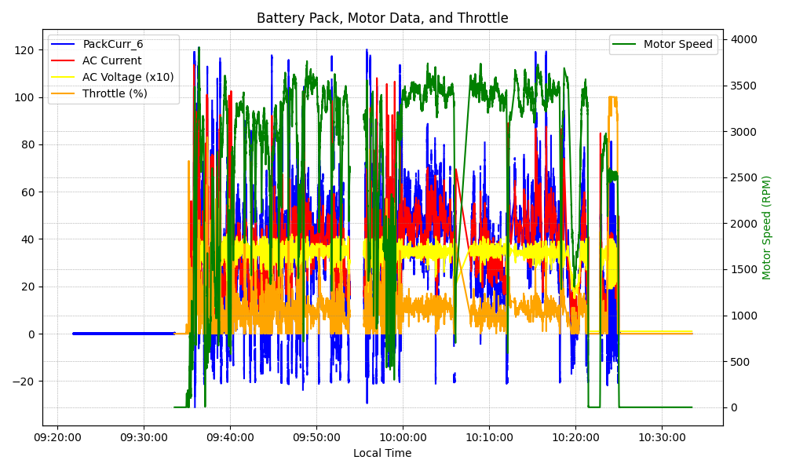
Graph Analysis

