Slide 1
Analysis Results from Folder - Battery_6

Slide 2
Analysis Results:
Metric | Value
Date and Time | 18/03/2024 10:34:38 to 18/03/2024 11:29:18
Byte Beam ID | 3
Total time taken for the ride | 0 days 00:54:40.102000
Actual Ampere-hours (Ah) | 28.200196666666667
Actual Watt-hours (Wh)- Calculated_UsingFormala | 1440.89082105
Starting SoC (Ah) | 10.381
Ending SoC (Ah) | 39.24
Starting SoC (%) | 99.0
Ending SoC (%) | 26.0
Total distance covered (km) | 41.187955125783546
Total energy consumption(WH/KM) | 34.98330559625201
Total SOC consumed(%) | 73.0
Mode | Custom mode 97.45% Sports mode 1.64% Eco mode 0.09%

Slide 3
Analysis Results:
Metric | Value
Peak Power(kW) | 6065.0832
Average Power(kW) | 1591.6560158883094
Total Energy Regenerated(kWh) | 55.08621596361111
Regenerative Effectiveness(%) | 3.6822902090515113
Highest Cell Voltage(V) | 3.364
Lowest Cell Voltage(V) | 3.028
Difference in Cell Voltage(V) | 0.33599999999999985
Minimum Temperature(C) | 29.0
Maximum Temperature(C) | 40.0
Difference in Temperature(C) | 11.0
Maximum Fet Temperature-BMS(C) | 67.0
Maximum Afe Temperature-BMS(C) | 61.0
Maximum PCB Temperature-BMS(C) | 59.0

Slide 4
Analysis Results:
Metric | Value
Maximum MCU Temperature(C) | 50.0
Maximum Motor Temperature(C) | 0.0
Abnormal Motor Temperature Detected(C) | False
highest cell temp(C) | 40.0
lowest cell temp(C) | 12.0
Difference between Highest and Lowest Cell Temperature at 100% SOC(C) | 28.0
Battery Voltage(V) | 55.0
Total energy charged(kWh)- Calculated_BatteryData | 1.5510108166666667
Electricity consumption units(kW) | 1.3135254206187896e-07
Cycle Count of battery | 49.0
Idling time percentage | 4.705053824742614
Time spent in 0-10 km/h | 5.073946141721721
Time spent in 10-20 km/h | 3.3166772862939737

Slide 5
Analysis Results:
Metric | Value
Time spent in 20-30 km/h | 6.314765753378718
Time spent in 30-40 km/h | 7.843992085583018
Time spent in 40-50 km/h | 14.762399812200275
Time spent in 50-60 km/h | 53.345182601696905
Time spent in 60-70 km/h | 4.104765418022067
Time spent in 70-80 km/h | 0.46279217948288
Time spent in 80-90 km/h | 0.0

Slide 6
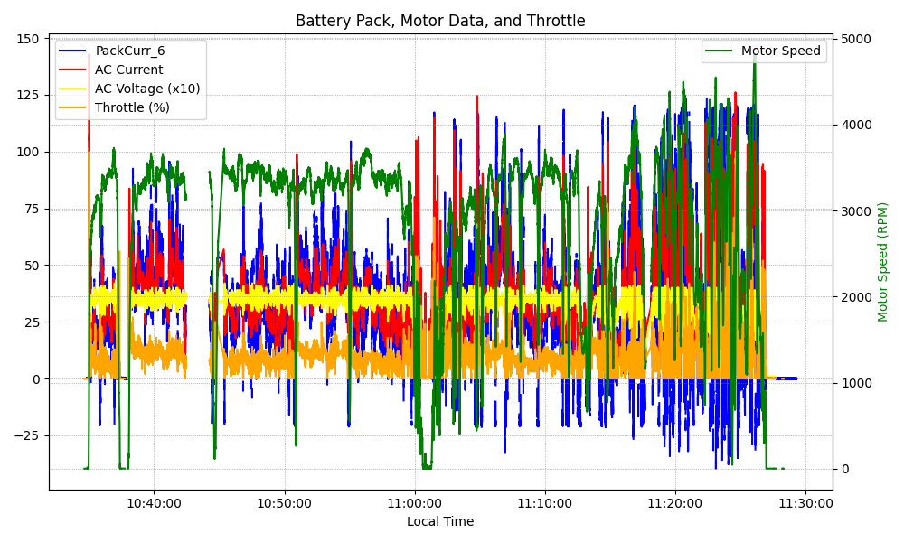
Graph Analysis

