Slide 1
Analysis Results from Folder - Battery_8

Slide 2
Analysis Results:
Metric | Value
Date and Time | 18/03/2024 11:48:44 to 18/03/2024 13:43:48
Byte Beam ID | 3
Total time taken for the ride | 0 days 01:55:03.920000
Actual Ampere-hours (Ah) | 24.73962638888889
Actual Watt-hours (Wh)- Calculated_UsingFormala | 1273.0199440466668
Starting SoC (Ah) | 39.591
Ending SoC (Ah) | 39.178
Starting SoC (%) | 99.0
Ending SoC (%) | 19.0
Total distance covered (km) | 30.192179256364454
Total energy consumption(WH/KM) | 42.16389725423071
Total SOC consumed(%) | 80.0
Mode | Custom mode 86.62% Eco mode 5.18% Sports mode 0.33%

Slide 3
Analysis Results:
Metric | Value
Peak Power(kW) | 6114.92718
Average Power(kW) | 667.3761174556575
Total Energy Regenerated(kWh) | 47.46261985722223
Regenerative Effectiveness(%) | 3.59433900565133
Highest Cell Voltage(V) | 3.49
Lowest Cell Voltage(V) | 3.123
Difference in Cell Voltage(V) | 0.367
Minimum Temperature(C) | 35.0
Maximum Temperature(C) | 47.0
Difference in Temperature(C) | 12.0
Maximum Fet Temperature-BMS(C) | 70.0
Maximum Afe Temperature-BMS(C) | 69.0
Maximum PCB Temperature-BMS(C) | 68.0

Slide 4
Analysis Results:
Metric | Value
Maximum MCU Temperature(C) | 49.0
Maximum Motor Temperature(C) | 0.0
Abnormal Motor Temperature Detected(C) | True
highest cell temp(C) | 47.0
lowest cell temp(C) | 35.0
Difference between Highest and Lowest Cell Temperature at 100% SOC(C) | 12.0
Battery Voltage(V) | 56.0
Total energy charged(kWh)- Calculated_BatteryData | 1.3854190777777777
Electricity consumption units(kW) | 5.574947598378233e-08
Cycle Count of battery | 123.0
Idling time percentage | 68.82749194571903
Time spent in 0-10 km/h | 3.6968336099450028
Time spent in 10-20 km/h | 1.462787594780175

Slide 5
Analysis Results:
Metric | Value
Time spent in 20-30 km/h | 2.5432002343063553
Time spent in 30-40 km/h | 3.4104591753717988
Time spent in 40-50 km/h | 5.057112174167725
Time spent in 50-60 km/h | 10.931042337856747
Time spent in 60-70 km/h | 3.7879527482182955
Time spent in 70-80 km/h | 0.24732337531322202
Time spent in 80-90 km/h | 0.0

Slide 6
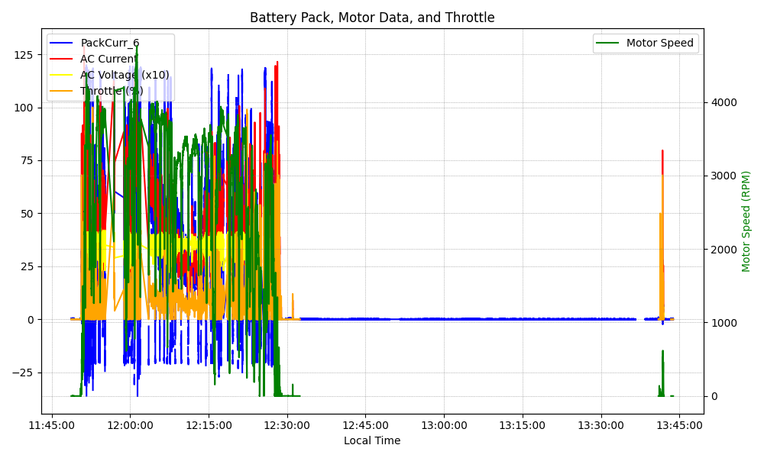
Graph Analysis

