Slide 1
Analysis Results from Folder - Battery_9

Slide 2
Analysis Results:
Metric | Value
Date and Time | 18/03/2024 13:45:08 to 18/03/2024 16:14:57
Byte Beam ID | 3
Total time taken for the ride | 0 days 02:29:48.876000
Actual Ampere-hours (Ah) | 36.461173611111114
Actual Watt-hours (Wh)- Calculated_UsingFormala | 1881.7904966572225
Starting SoC (Ah) | 3.315
Ending SoC (Ah) | 39.591
Starting SoC (%) | 99.0
Ending SoC (%) | 8.0
Total distance covered (km) | 63.45552507442862
Total energy consumption(WH/KM) | 29.655266337328733
Total SOC consumed(%) | 91.0
Mode | Eco mode 97.82% Custom mode 0.58% Sports mode 0.01%

Slide 3
Analysis Results:
Metric | Value
Peak Power(kW) | 2542.2963799999998
Average Power(kW) | 757.513785974058
Total Energy Regenerated(kWh) | 111.9501806325
Regenerative Effectiveness(%) | 5.615082337823609
Highest Cell Voltage(V) | 3.484
Lowest Cell Voltage(V) | 3.097
Difference in Cell Voltage(V) | 0.387
Minimum Temperature(C) | 30.0
Maximum Temperature(C) | 43.0
Difference in Temperature(C) | 13.0
Maximum Fet Temperature-BMS(C) | 49.0
Maximum Afe Temperature-BMS(C) | 52.0
Maximum PCB Temperature-BMS(C) | 49.0

Slide 4
Analysis Results:
Metric | Value
Maximum MCU Temperature(C) | 44.0
Maximum Motor Temperature(C) | 0.0
Abnormal Motor Temperature Detected(C) | False
highest cell temp(C) | 43.0
lowest cell temp(C) | 26.0
Difference between Highest and Lowest Cell Temperature at 100% SOC(C) | 17.0
Battery Voltage(V) | 59.0
Total energy charged(kWh)- Calculated_BatteryData | 2.151209243055556
Electricity consumption units(kW) | 6.648399233099553e-08
Cycle Count of battery | 53.0
Idling time percentage | 18.57972430261587
Time spent in 0-10 km/h | 5.6347009660262675
Time spent in 10-20 km/h | 4.34711820253989

Slide 5
Analysis Results:
Metric | Value
Time spent in 20-30 km/h | 8.897753174861608
Time spent in 30-40 km/h | 42.980028220992075
Time spent in 40-50 km/h | 18.011234125691956
Time spent in 50-60 km/h | 0.0
Time spent in 60-70 km/h | 0.0
Time spent in 70-80 km/h | 0.0
Time spent in 80-90 km/h | 0.0

Slide 6
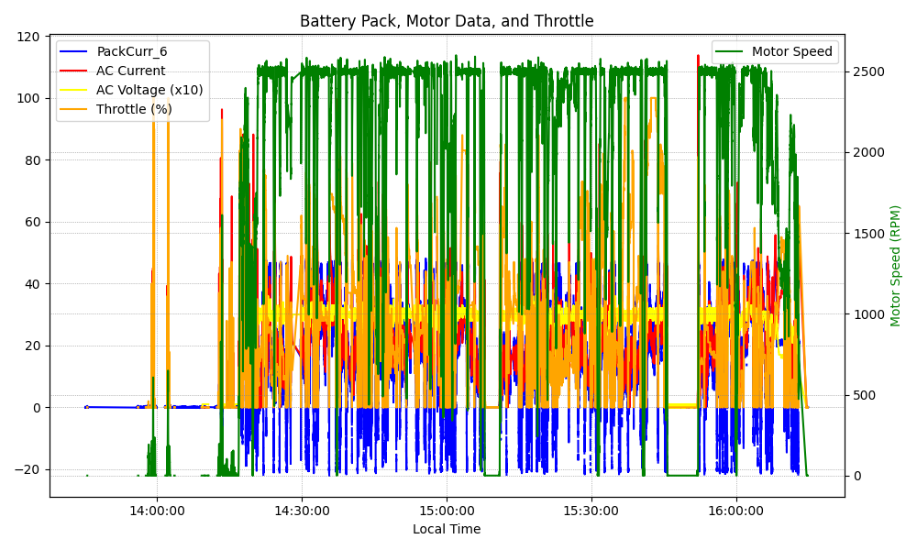
Graph Analysis

