Slide 1
Analysis Results from Folder - Battery_1

Slide 2
Analysis Results:
Metric | Value
Date and Time | 19/03/2024 08:12:31 to 19/03/2024 10:47:48
Byte Beam ID | 3
Total time taken for the ride | 0 days 02:35:16.868000
Actual Ampere-hours (Ah) | 36.001868888888886
Actual Watt-hours (Wh)- Calculated_UsingFormala | 1855.4119009116666
Starting SoC (Ah) | 4.034
Ending SoC (Ah) | 39.422
Starting SoC (%) | 99.0
Ending SoC (%) | 10.0
Total distance covered (km) | 66.59884492547438
Total energy consumption(WH/KM) | 27.859520731747143
Total SOC consumed(%) | 89.0
Mode | Eco mode 99.73%

Slide 3
Analysis Results:
Metric | Value
Peak Power(kW) | 2435.9276250000003
Average Power(kW) | 721.0149874009068
Total Energy Regenerated(kWh) | 61.25442783138889
Regenerative Effectiveness(%) | 3.195883754662679
Highest Cell Voltage(V) | 3.374
Lowest Cell Voltage(V) | 3.072
Difference in Cell Voltage(V) | 0.30200000000000005
Minimum Temperature(C) | 27.0
Maximum Temperature(C) | 37.0
Difference in Temperature(C) | 10.0
Maximum Fet Temperature-BMS(C) | 45.0
Maximum Afe Temperature-BMS(C) | 48.0
Maximum PCB Temperature-BMS(C) | 47.0

Slide 4
Analysis Results:
Metric | Value
Maximum MCU Temperature(C) | 38.0
Maximum Motor Temperature(C) | 0.0
Abnormal Motor Temperature Detected(C) | False
highest cell temp(C) | 37.0
lowest cell temp(C) | 27.0
Difference between Highest and Lowest Cell Temperature at 100% SOC(C) | 10.0
Battery Voltage(V) | 55.0
Total energy charged(kWh)- Calculated_BatteryData | 1.9801027888888887
Electricity consumption units(kW) | 5.904127871072732e-08
Cycle Count of battery | 125.0
Idling time percentage | 21.48197090384074
Time spent in 0-10 km/h | 5.304114818485482
Time spent in 10-20 km/h | 4.557745720613246

Slide 5
Analysis Results:
Metric | Value
Time spent in 20-30 km/h | 9.022501192967
Time spent in 30-40 km/h | 44.5484466957873
Time spent in 40-50 km/h | 13.88858299991435
Time spent in 50-60 km/h | 0.0
Time spent in 60-70 km/h | 0.0
Time spent in 70-80 km/h | 0.0
Time spent in 80-90 km/h | 0.0

Slide 6
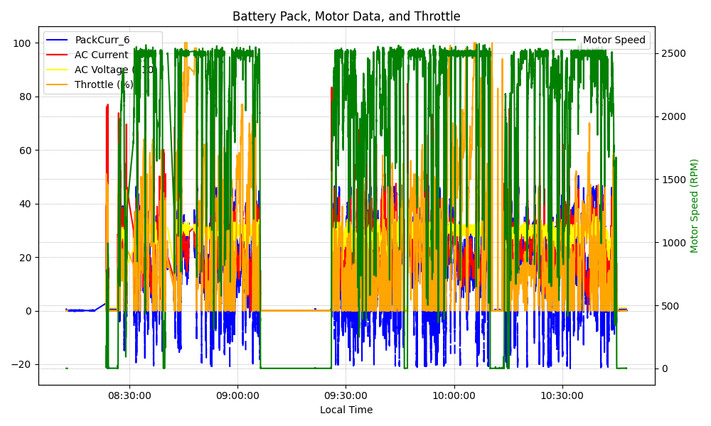
Graph Analysis

