Slide 1
Analysis Results from Folder - Battery_2

Slide 2
Analysis Results:
Metric | Value
Date and Time | 19/03/2024 10:48:53 to 19/03/2024 12:43:28
Byte Beam ID | 3
Total time taken for the ride | 0 days 01:54:34.983000
Actual Ampere-hours (Ah) | 27.36969
Actual Watt-hours (Wh)- Calculated_UsingFormala | 1418.3649313086112
Starting SoC (Ah) | 2.014
Ending SoC (Ah) | 39.38
Starting SoC (%) | 99.0
Ending SoC (%) | 5.0
Total distance covered (km) | 53.947991706514316
Total energy consumption(WH/KM) | 26.291338869938713
Total SOC consumed(%) | 94.0
Mode | Eco mode 98.38%

Slide 3
Analysis Results:
Metric | Value
Peak Power(kW) | 2534.060169
Average Power(kW) | 746.289645236919
Total Energy Regenerated(kWh) | 62.91977908944444
Regenerative Effectiveness(%) | 4.247649263357106
Highest Cell Voltage(V) | 3.398
Lowest Cell Voltage(V) | 3.135
Difference in Cell Voltage(V) | 0.26300000000000034
Minimum Temperature(C) | 28.0
Maximum Temperature(C) | 37.0
Difference in Temperature(C) | 9.0
Maximum Fet Temperature-BMS(C) | 44.0
Maximum Afe Temperature-BMS(C) | 49.0
Maximum PCB Temperature-BMS(C) | 46.0

Slide 4
Analysis Results:
Metric | Value
Maximum MCU Temperature(C) | 42.0
Maximum Motor Temperature(C) | 0.0
Abnormal Motor Temperature Detected(C) | False
highest cell temp(C) | 37.0
lowest cell temp(C) | 28.0
Difference between Highest and Lowest Cell Temperature at 100% SOC(C) | 9.0
Battery Voltage(V) | 55.0
Total energy charged(kWh)- Calculated_BatteryData | 1.50533295
Electricity consumption units(kW) | 6.083038138880807e-08
Cycle Count of battery | 125.0
Idling time percentage | 17.876541579303627
Time spent in 0-10 km/h | 4.753099668158029
Time spent in 10-20 km/h | 5.850984794703736

Slide 5
Analysis Results:
Metric | Value
Time spent in 20-30 km/h | 9.942051476779316
Time spent in 30-40 km/h | 40.75217513331462
Time spent in 40-50 km/h | 19.255089069026432
Time spent in 50-60 km/h | 0.0
Time spent in 60-70 km/h | 0.0
Time spent in 70-80 km/h | 0.0
Time spent in 80-90 km/h | 0.0

Slide 6
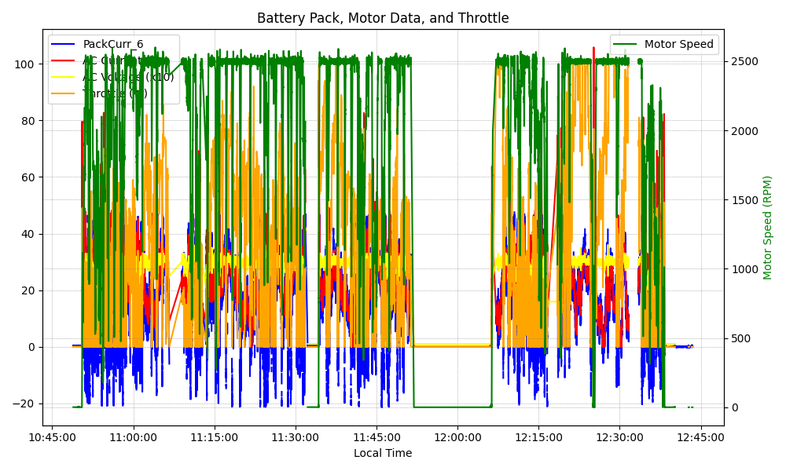
Graph Analysis

