Slide 1
Analysis Results from Folder - Battery_3

Slide 2
Analysis Results:
Metric | Value
Date and Time | 19/03/2024 12:44:54 to 19/03/2024 14:29:29
Byte Beam ID | 3
Total time taken for the ride | 0 days 01:44:35.365000
Actual Ampere-hours (Ah) | 37.11741222222223
Actual Watt-hours (Wh)- Calculated_UsingFormala | 1886.8402937972219
Starting SoC (Ah) | 2.372
Ending SoC (Ah) | 36.549
Starting SoC (%) | 99.0
Ending SoC (%) | 5.0
Total distance covered (km) | 48.715203176288476
Total energy consumption(WH/KM) | 38.73206249328789
Total SOC consumed(%) | 94.0
Mode | Sports mode 67.69% Eco mode 21.92%

Slide 3
Analysis Results:
Metric | Value
Peak Power(kW) | 5601.310848000001
Average Power(kW) | 1089.7842223118882
Total Energy Regenerated(kWh) | 137.55547194583335
Regenerative Effectiveness(%) | 6.794890321030856
Highest Cell Voltage(V) | 3.474
Lowest Cell Voltage(V) | 3.016
Difference in Cell Voltage(V) | 0.4580000000000002
Minimum Temperature(C) | 30.0
Maximum Temperature(C) | 47.0
Difference in Temperature(C) | 17.0
Maximum Fet Temperature-BMS(C) | 65.0
Maximum Afe Temperature-BMS(C) | 62.0
Maximum PCB Temperature-BMS(C) | 60.0

Slide 4
Analysis Results:
Metric | Value
Maximum MCU Temperature(C) | 56.0
Maximum Motor Temperature(C) | 0.0
Abnormal Motor Temperature Detected(C) | True
highest cell temp(C) | 47.0
lowest cell temp(C) | -1.0
Difference between Highest and Lowest Cell Temperature at 100% SOC(C) | 48.0
Battery Voltage(V) | 55.0
Total energy charged(kWh)- Calculated_BatteryData | 2.0414576722222226
Electricity consumption units(kW) | 9.036997220992575e-08
Cycle Count of battery | 145.0
Idling time percentage | 25.58249716577269
Time spent in 0-10 km/h | 7.00688674935278
Time spent in 10-20 km/h | 7.064417333626627

Slide 5
Analysis Results:
Metric | Value
Time spent in 20-30 km/h | 9.962943535423612
Time spent in 30-40 km/h | 16.05610924042708
Time spent in 40-50 km/h | 13.1203573664529
Time spent in 50-60 km/h | 14.834430362611888
Time spent in 60-70 km/h | 5.92395810419804
Time spent in 70-80 km/h | 0.0
Time spent in 80-90 km/h | 0.0

Slide 6
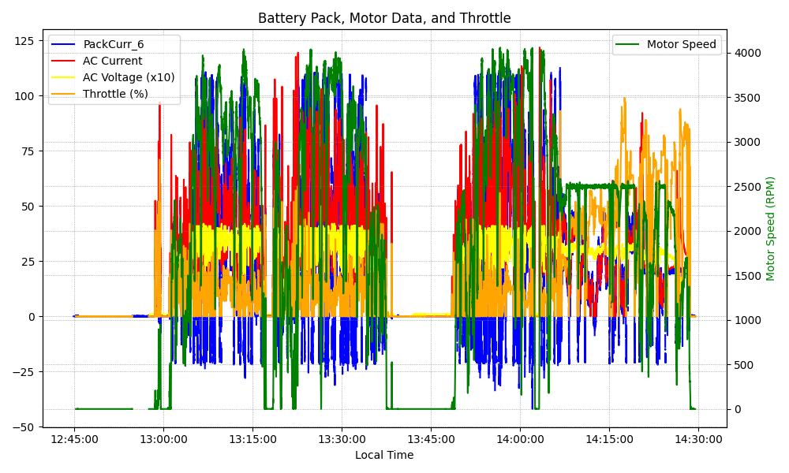
Graph Analysis

