Slide 1
Analysis Results from Folder - Battery_4

Slide 2
Analysis Results:
Metric | Value
Date and Time | 19/03/2024 14:30:46 to 19/03/2024 15:21:08
Byte Beam ID | 3
Total time taken for the ride | 0 days 00:50:22.272000
Actual Ampere-hours (Ah) | 20.957127777777778
Actual Watt-hours (Wh)- Calculated_UsingFormala | 1075.1627348413888
Starting SoC (Ah) | 13.86
Ending SoC (Ah) | 36.514
Starting SoC (%) | 92.0
Ending SoC (%) | 35.0
Total distance covered (km) | 26.88228575137814
Total energy consumption(WH/KM) | 39.99521263872696
Total SOC consumed(%) | 57.0
Mode | Sports mode 92.20% Eco mode 6.97%

Slide 3
Analysis Results:
Metric | Value
Peak Power(kW) | 5494.897427
Average Power(kW) | 1293.2127782923487
Total Energy Regenerated(kWh) | 93.54125908388889
Regenerative Effectiveness(%) | 8.003845248249364
Highest Cell Voltage(V) | 3.459
Lowest Cell Voltage(V) | 3.091
Difference in Cell Voltage(V) | 0.3679999999999999
Minimum Temperature(C) | 1.0
Maximum Temperature(C) | 42.0
Difference in Temperature(C) | 41.0
Maximum Fet Temperature-BMS(C) | 65.0
Maximum Afe Temperature-BMS(C) | 60.0
Maximum PCB Temperature-BMS(C) | 58.0

Slide 4
Analysis Results:
Metric | Value
Maximum MCU Temperature(C) | 54.0
Maximum Motor Temperature(C) | 0.0
Abnormal Motor Temperature Detected(C) | False
highest cell temp(C) | 42.0
lowest cell temp(C) | 1.0
Difference between Highest and Lowest Cell Temperature at 100% SOC(C) | 41.0
Battery Voltage(V) | 76.0
Total energy charged(kWh)- Calculated_BatteryData | 1.592741711111111
Electricity consumption units(kW) | 1.4640246627611507e-07
Cycle Count of battery | 146.0
Idling time percentage | 15.692050475697625
Time spent in 0-10 km/h | 6.460730066478246
Time spent in 10-20 km/h | 7.770391306078579

Slide 5
Analysis Results:
Metric | Value
Time spent in 20-30 km/h | 9.764738664862067
Time spent in 30-40 km/h | 15.891087138250864
Time spent in 40-50 km/h | 23.812746307869908
Time spent in 50-60 km/h | 20.45300744397118
Time spent in 60-70 km/h | 0.03582659925958362
Time spent in 70-80 km/h | 0.0
Time spent in 80-90 km/h | 0.0

Slide 6
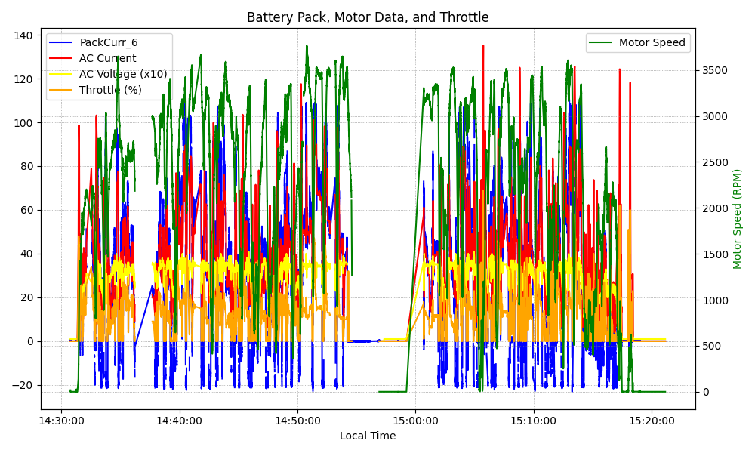
Graph Analysis

