Slide 1
Analysis Results from Folder - Battery_5

Slide 2
Analysis Results:
Metric | Value
Date and Time | 19/03/2024 15:22:24 to 19/03/2024 17:07:04
Byte Beam ID | 3
Total time taken for the ride | 0 days 01:44:39.879000
Actual Ampere-hours (Ah) | 30.837318333333332
Actual Watt-hours (Wh)- Calculated_UsingFormala | 1580.9795113180558
Starting SoC (Ah) | 4.706
Ending SoC (Ah) | 39.601
Starting SoC (%) | 99.0
Ending SoC (%) | 11.0
Total distance covered (km) | 39.622755388537215
Total energy consumption(WH/KM) | 39.90079679757532
Total SOC consumed(%) | 88.0
Mode | Sports mode 78.64% Eco mode 20.50%

Slide 3
Analysis Results:
Metric | Value
Peak Power(kW) | 5523.495696
Average Power(kW) | 910.7899249071852
Total Energy Regenerated(kWh) | 120.68788581777778
Regenerative Effectiveness(%) | 7.092331087785659
Highest Cell Voltage(V) | 3.502
Lowest Cell Voltage(V) | 3.083
Difference in Cell Voltage(V) | 0.4189999999999996
Minimum Temperature(C) | 39.0
Maximum Temperature(C) | 48.0
Difference in Temperature(C) | 9.0
Maximum Fet Temperature-BMS(C) | 72.0
Maximum Afe Temperature-BMS(C) | 68.0
Maximum PCB Temperature-BMS(C) | 66.0

Slide 4
Analysis Results:
Metric | Value
Maximum MCU Temperature(C) | 57.0
Maximum Motor Temperature(C) | 0.0
Abnormal Motor Temperature Detected(C) | False
highest cell temp(C) | 48.0
lowest cell temp(C) | 39.0
Difference between Highest and Lowest Cell Temperature at 100% SOC(C) | 9.0
Battery Voltage(V) | 56.0
Total energy charged(kWh)- Calculated_BatteryData | 1.7268898266666666
Electricity consumption units(kW) | 7.639618068458648e-08
Cycle Count of battery | 52.0
Idling time percentage | 42.69054422220746
Time spent in 0-10 km/h | 3.4753139743504553
Time spent in 10-20 km/h | 4.533523822180876

Slide 5
Analysis Results:
Metric | Value
Time spent in 20-30 km/h | 7.173234101933683
Time spent in 30-40 km/h | 14.82324406937338
Time spent in 40-50 km/h | 10.186723370323609
Time spent in 50-60 km/h | 13.612200146189116
Time spent in 60-70 km/h | 3.2709814605621634
Time spent in 70-80 km/h | 0.0
Time spent in 80-90 km/h | 0.0

Slide 6
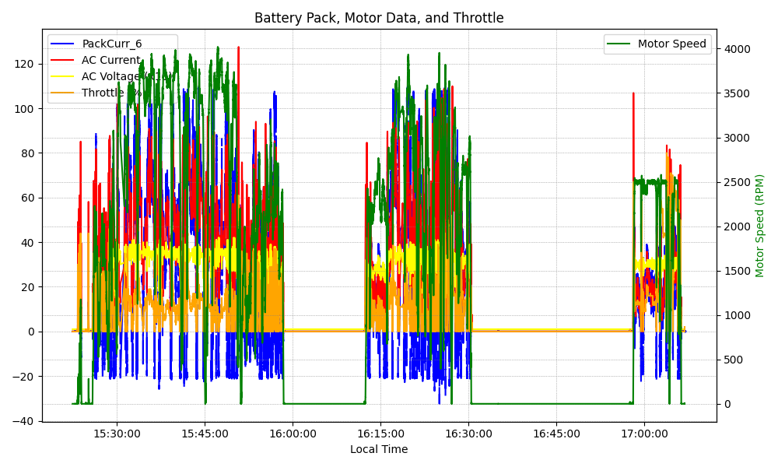
Graph Analysis

